Slide 1
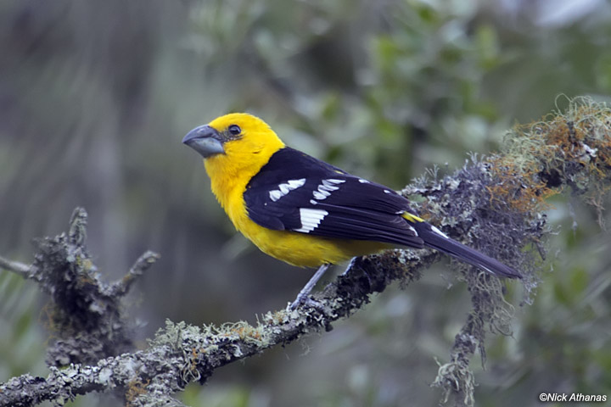
What do you think these birds eat?
Notes:
Small fish, shrimp, snails and insects Insects, seeds and fruit

Slide 2
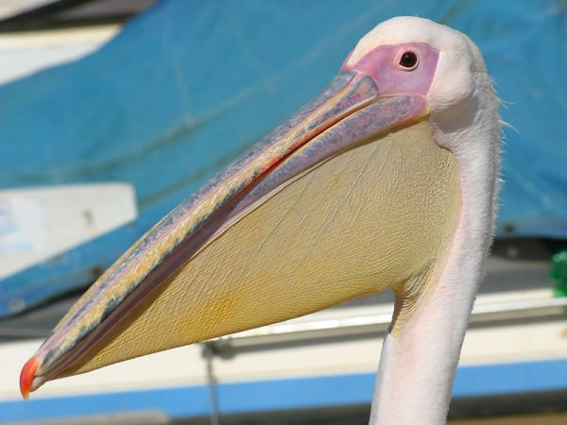
These?
Notes:
Snakes, toads, gophers, mice, bird eggs, lizards fish (can also eat frogs, crustaceans, small birds and eggs)

Slide 3
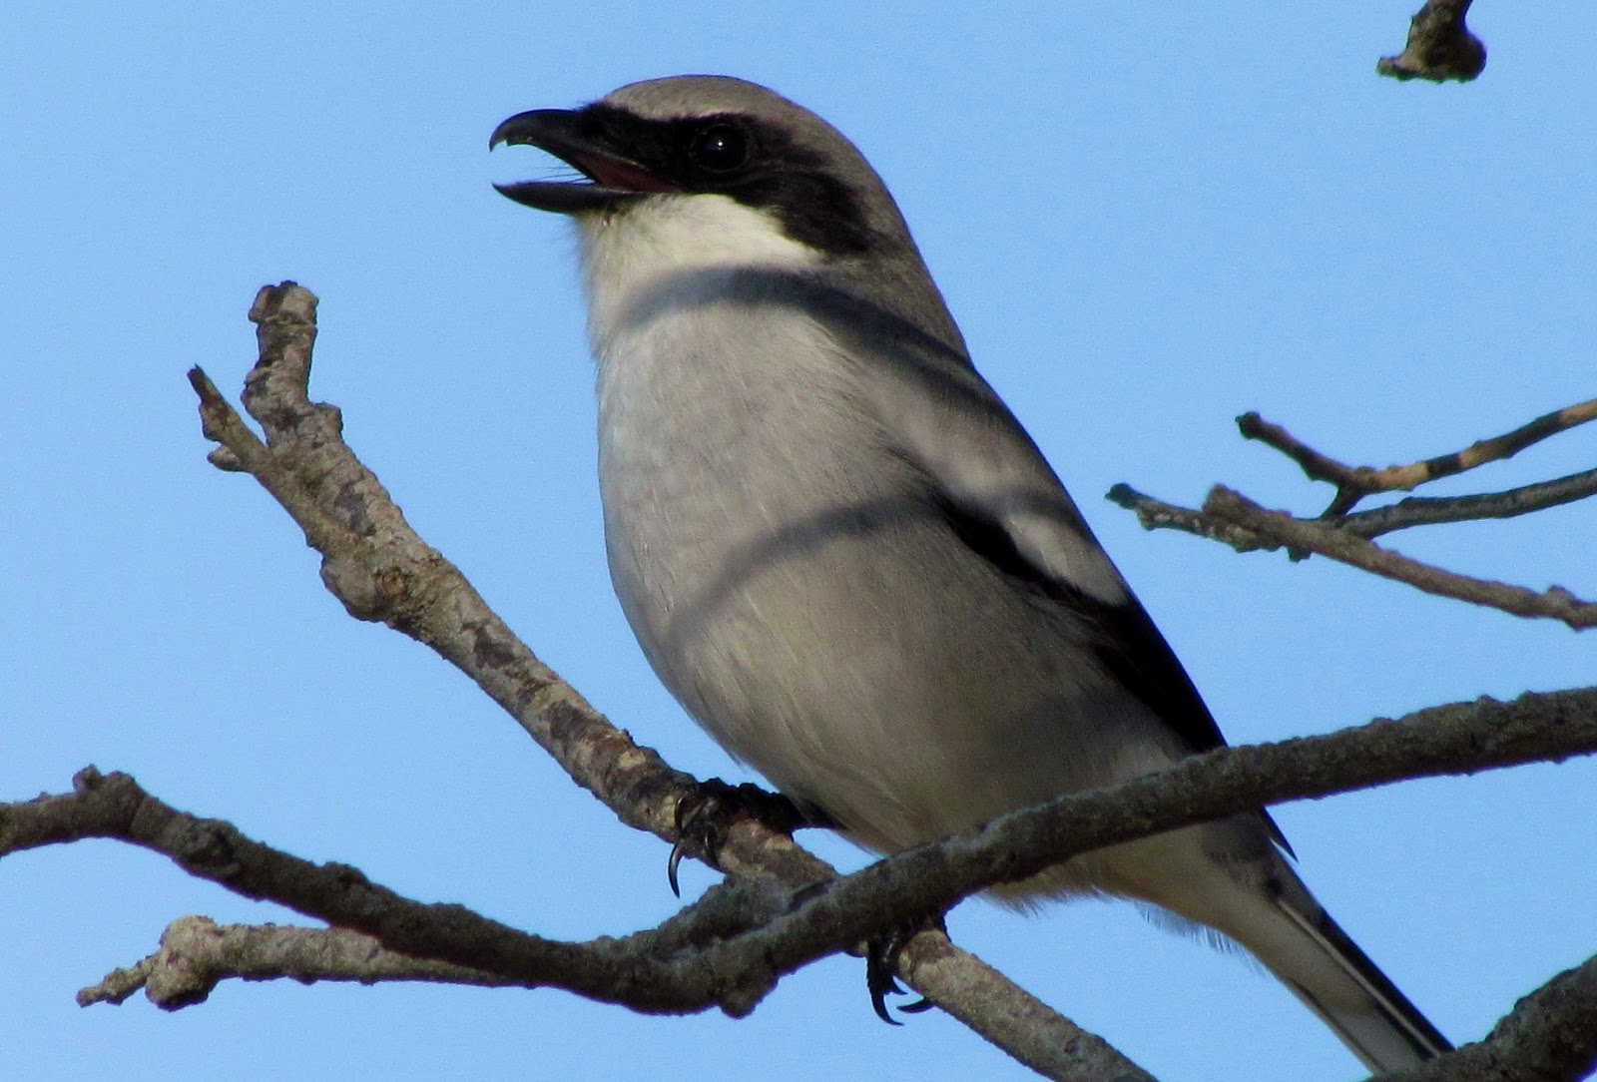
And these?
Notes:
Nectar and some insects (have a “quick-snapping” beak and sticky tongue) //Called the “butcher bird”: insects, birds, lizards, mice – impales prey on thorns, barbed wire etc.

Slide 4
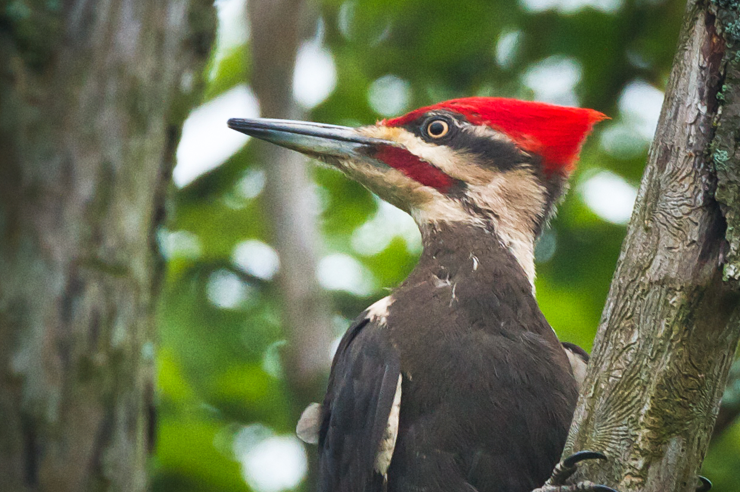
What do you think this bird eats?
Notes:
The Pileated woodpecker is the largest north American woodpecker (about the size of a crow). It uses its beak to bore holes in trees to find ants and insects. It has a barbed tongue to help it pull insects out of the holes it makes.

