Slide 1
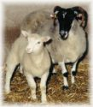
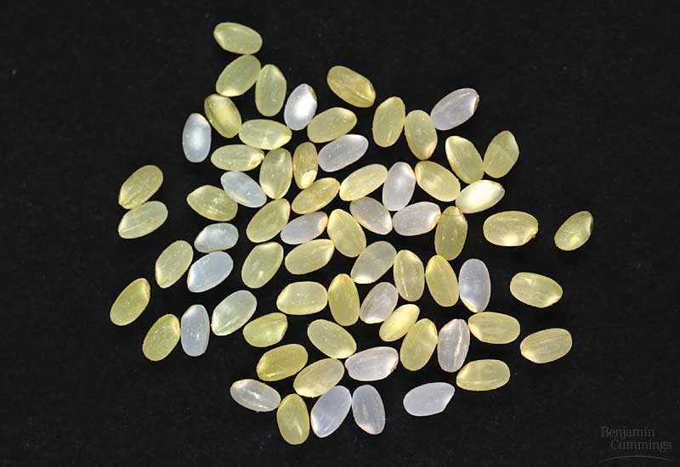
Biotechnology
Dolly and surrogate Mom
Embryonic stem cells and gene therapy
Genetically modified rice.

Slide 2
Biotechnology
Biotechnology, defined broadly, is the engineering of organisms for useful purposes.
Often, biotechnology involves the creation of hybrid genes and their introduction into organisms in which some or all of the gene is not normally present.
Fourteen month-old genetically engineered (“biotech”) salmon (left) and standard salmon (right).

Slide 3
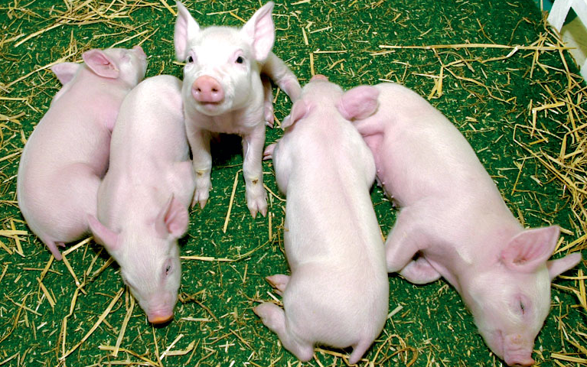
Why Clone Animals?
Five genetically identical cloned pigs.
To answer questions of basic biology
For pharmaceutical production.
For herd improvement.
To satisfy our desires (e.g. pet cloning).

Slide 4
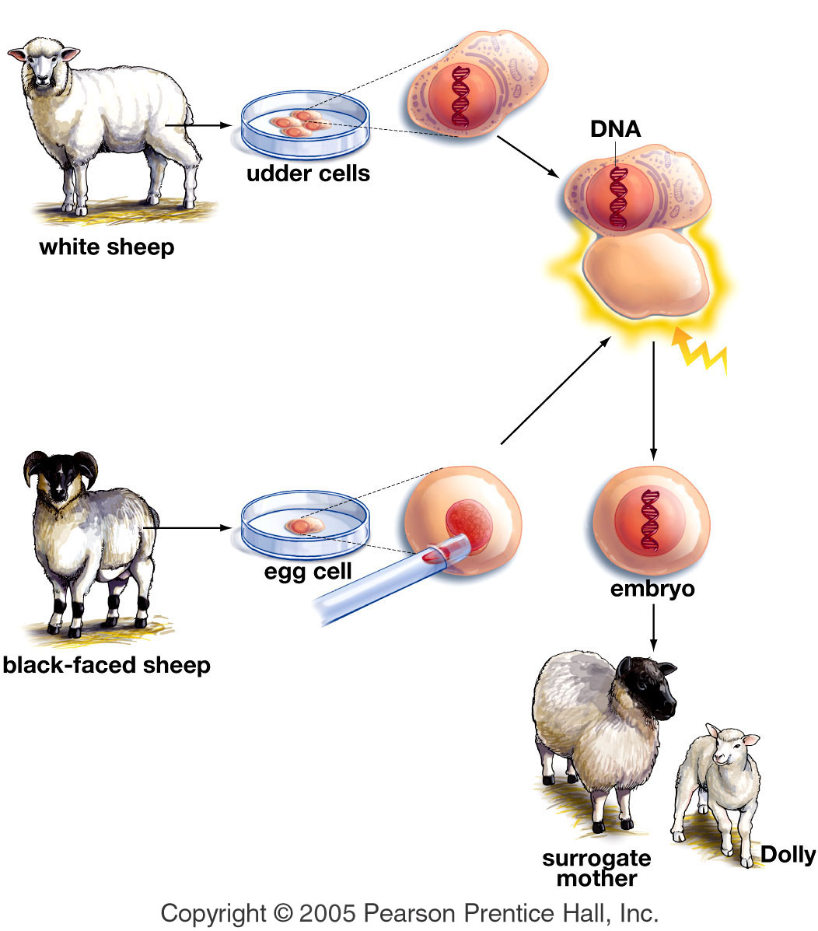
The Biotechnology of Reproductive Cloning
Even under the best of circumstances, the current technology of cloning is very inefficient.
Cloning provides the most direct demonstration that all cells of an individual share a common genetic blueprint.

Slide 5
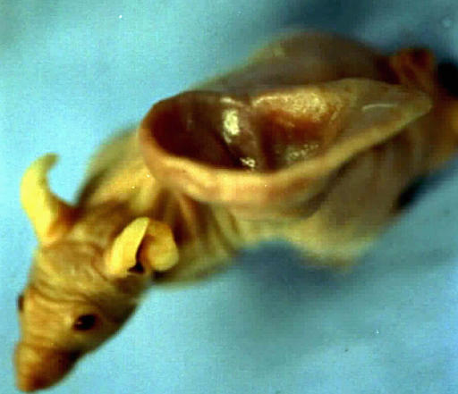
Human ear grown on a mouse

Slide 6
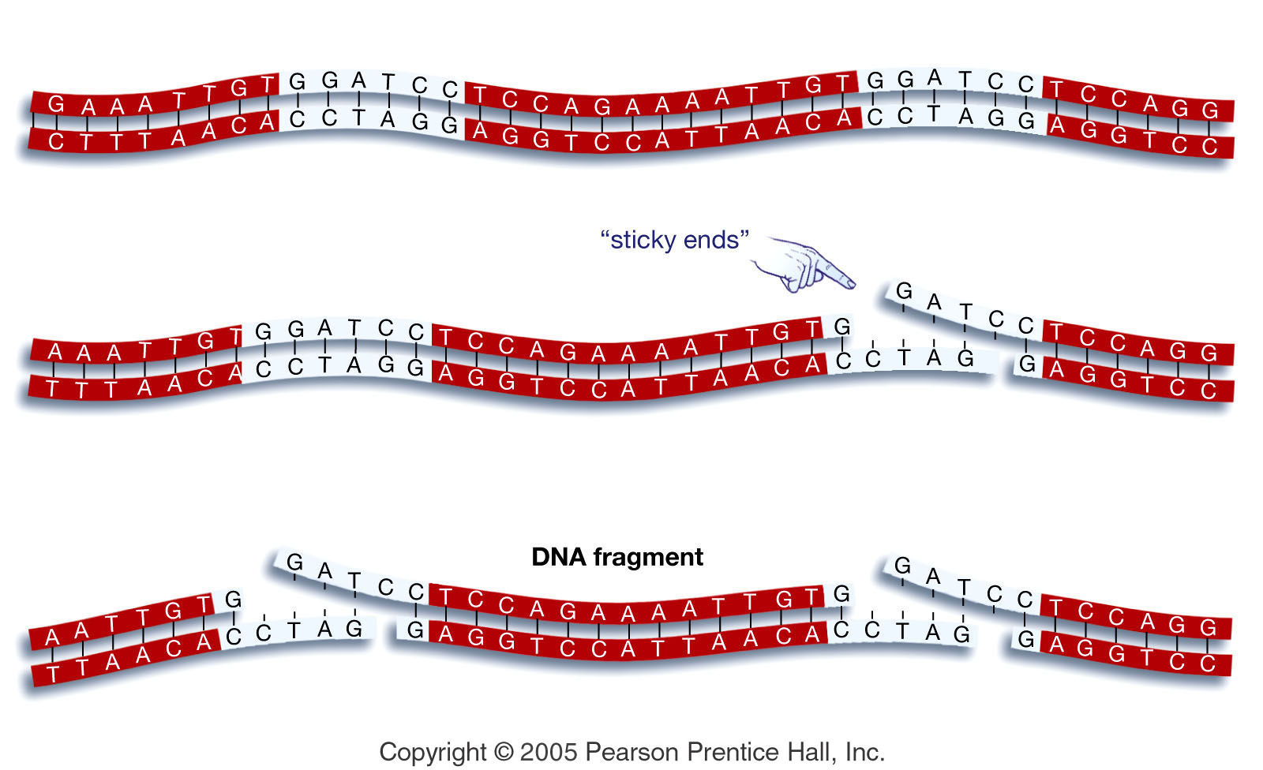
Recombinant DNA, Gene Cloning, and Pharmaceutical Production
DNA can be cut at specific sequences using restriction enzymes.
This creates DNA fragments useful for gene cloning.

Slide 7
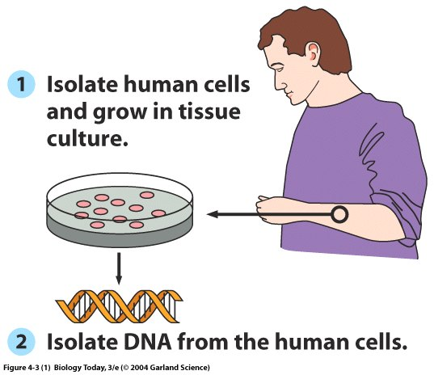
Harnessing the Power of Recombinant DNA Technology – Human Insulin Production by Bacteria

Slide 8
Human Insulin Production by Bacteria
and cut with a restriction enzyme
6) join the plasmid and human fragment

Slide 9
Human Insulin Production by Bacteria
Mix the recombinant plasmid with bacteria.
Screening bacterial cells to learn which contain the human insulin gene is the hard part.

Slide 10
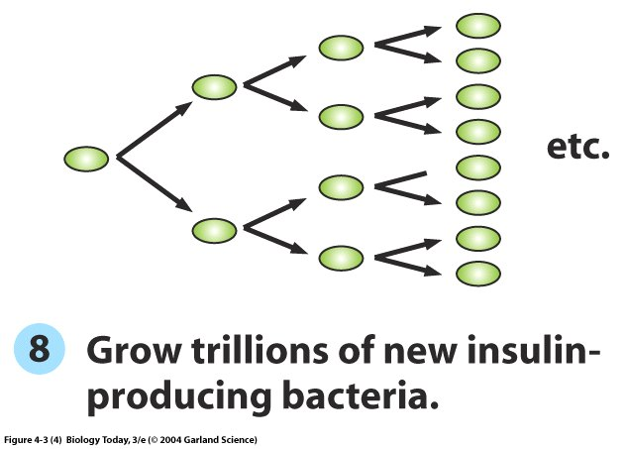
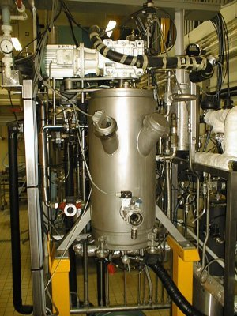
Route to the Production by Bacteria of Human Insulin
One cell with the recombinant plasmid
A fermentor used to grow recombinant bacteria.
This is the step when gene cloning takes place.
The single recombinant plasmid replicates within a cell.
Then the single cell with many recombinant plasmids produces trillions of like cells with recombinant plasmid – and the human insulin gene.

Slide 11
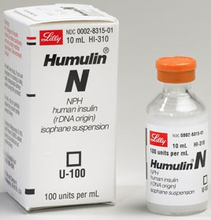
Route to the Production by Bacteria of Human Insulin
The final steps are to collect the bacteria, break open the cells, and purify the insulin protein expressed from the recombinant human insulin gene.

Slide 12
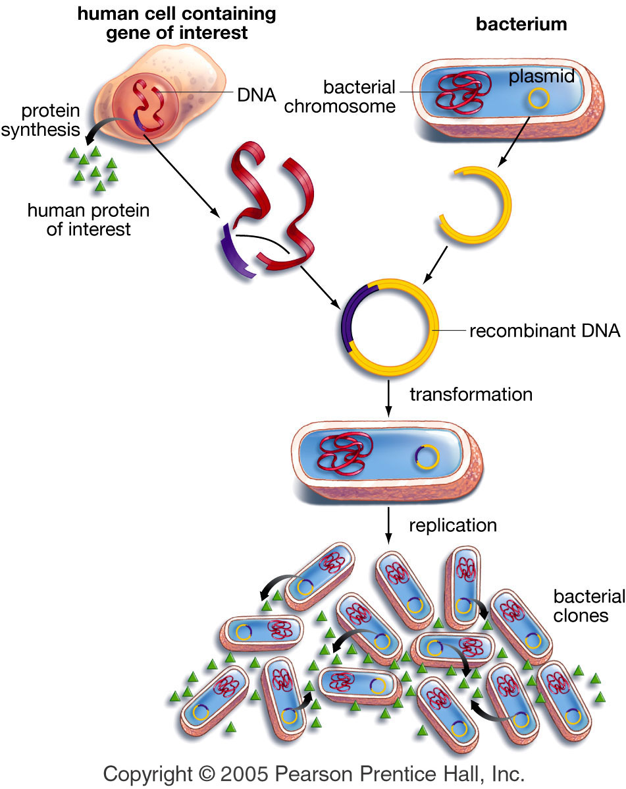
Route to the Production by Bacteria of Human Insulin
Overview of gene cloning.
Cloning animation

Slide 13
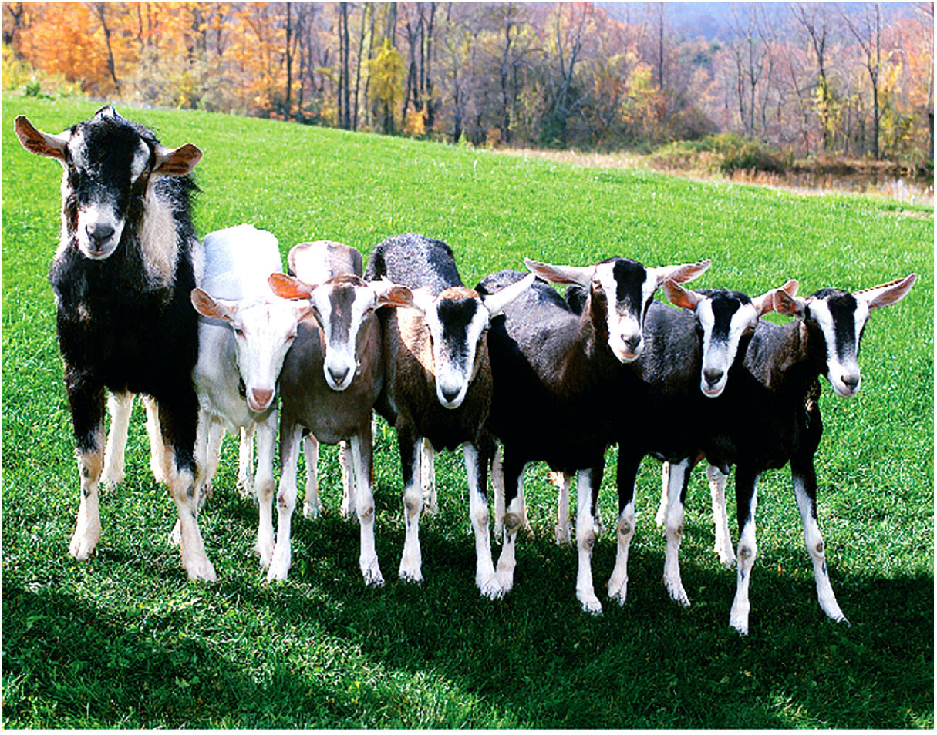
Pharming
Pharming is the production of pharmaceuticals in animals engineered to contain a foreign, drug-producing gene.
These goats contain the human gene for a clot-dissolving protein that is produced in their milk.

Slide 14
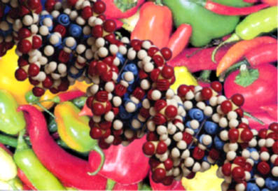
Genetically Modified Foods
Many of our crops in the US are genetically modified.
Should they be?

Slide 15
Golden Rice is Modified to be Provide a Dietary Source of Vitamin A
Golden rice (yellow) with standard rice (white).
Worldwide, 7% of children suffer vitamin A deficiency, many of them living in regions in which rice is a staple of the diet.

Slide 16
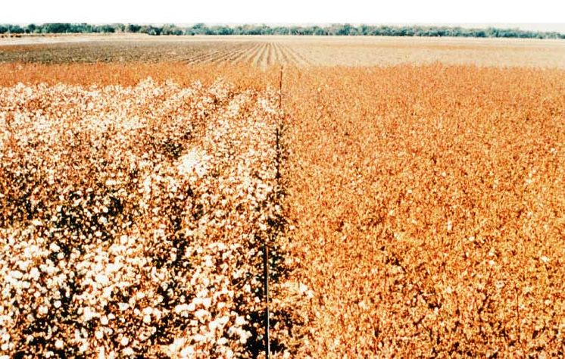
Genetically Modified Crops
Genetically Modified Cotton
(contains a bacterial gene for pest resistance)
Standard Cotton

Slide 17
Your Assignment:
You will create a
Genetically Modified Organism.
Think of two organisms to combine specific DNA (can add single trait)
Create a new “breed” of an organism that has new and different characteristics.
Add a picture and a descriptive summary of your creation.

