Slide 1
Biome Project

Slide 2
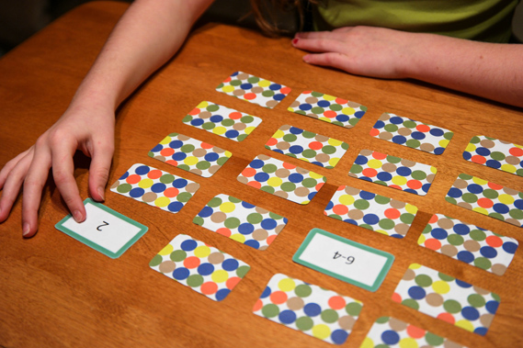
Biome Memory

Slide 3
18 Biomes = 36 cards total
1st card for each pair should have the name of the biome with a representative picture in color (include plants and animals - indicative scenery)
2nd card of each pair should have descriptions including: temperature, precipitation, types of plants and animals, location on globe, soil fertility and fire cycle ( for chaparral, grassland and savanna).

Slide 4
Biomes to Include:
The 10 terrestrial biomes on your print-out
3 Freshwater “biomes”: Lakes, Streams/Rivers, Swamps/Marshes
5 Marine “biomes”: Pelagic, Benthic, Estuaries, Coral Reefs, Mangroves

