Slide 1
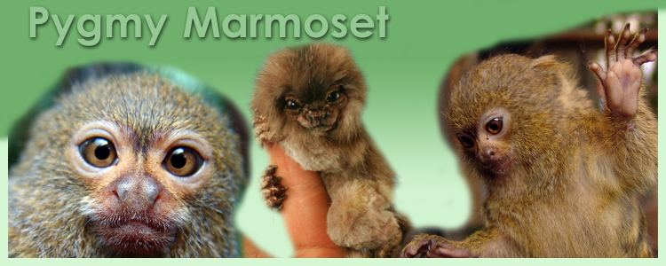
How are these marmosets similar to each other? How are they different?
How would the marmosets be affected if they lived in an area without many other species of plants or animals?
If additional plant or animal species were introduced to their habitat, would it be beneficial to the marmosets? Explain.

