Slide 1
AP Environmental Science
APES

Slide 2
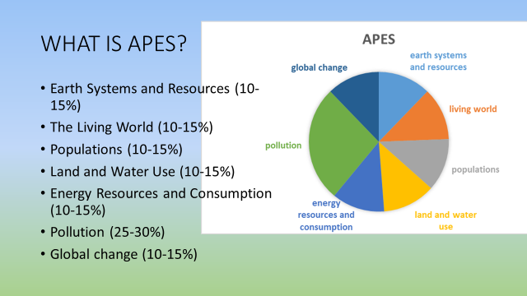
Title and Content Layout with List
Add your first bullet point here
Add your second bullet point here
Add your third bullet point here

Slide 3
AP Credit: It officially counts!!
Class grades:
50% Assessments
25% Labs and Projects
25% Classwork and Homework

Slide 4
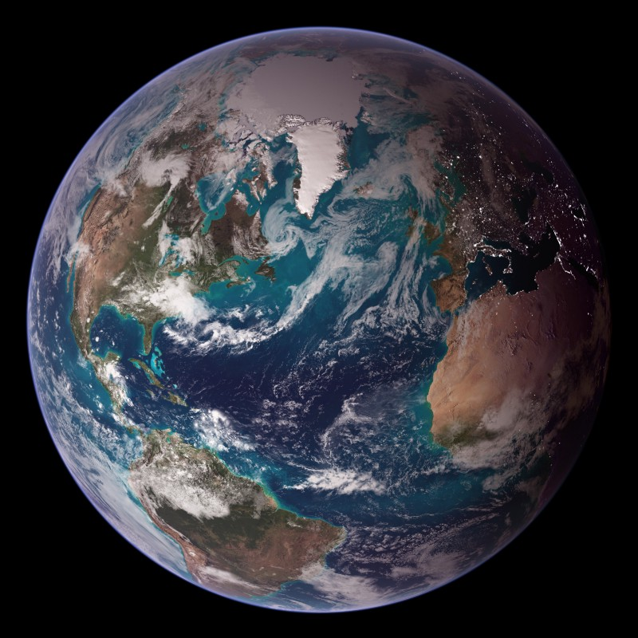
Earth Systems and Resources (10 – 15%)
Earth science concepts
The atmosphere
Global water resources and use
Soil and soil dynamics

Slide 5
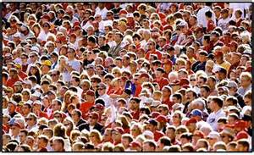
Populations (10-15%)
Carrying capacity, reproductive strategies, survivorship, island biogeography
Human population

Slide 6
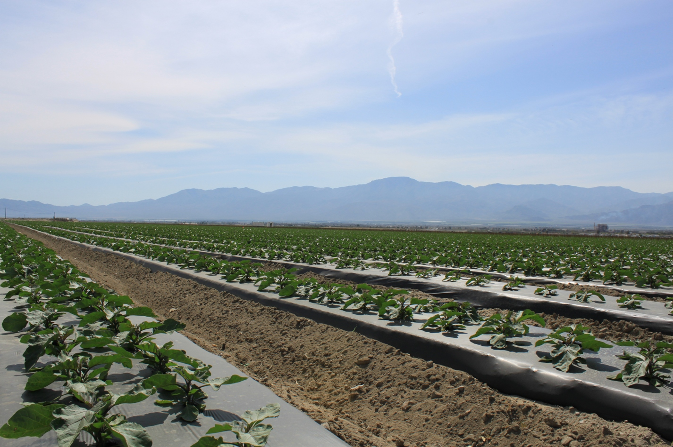
Land and Water Use (10-15%)
Agriculture
Forestry
Range lands
Mining
Fishing
Global economies
Other land use (urban, transportation, public/private, conservation, sustainability)

Slide 7
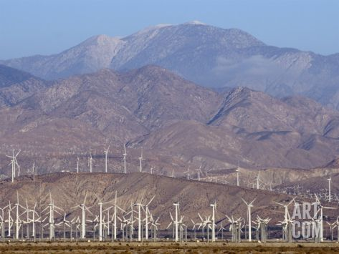
Energy Resources and Consumption (10-15%)
Energy concepts
Consumption
Fossil fuels
Nuclear
Hydroelectric
Energy conservation
Renewable energy

Slide 8
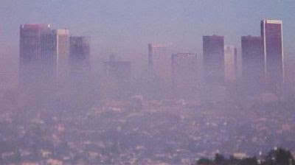
Pollution (25-30%)
Types:
Air
Water
Light
Noise
Solid waste
Impacts on the environment and human health:
Economic impact

Slide 9
Global Change (10-15%)
Stratospheric ozone
Global warming
Loss of biodiversity

Slide 10
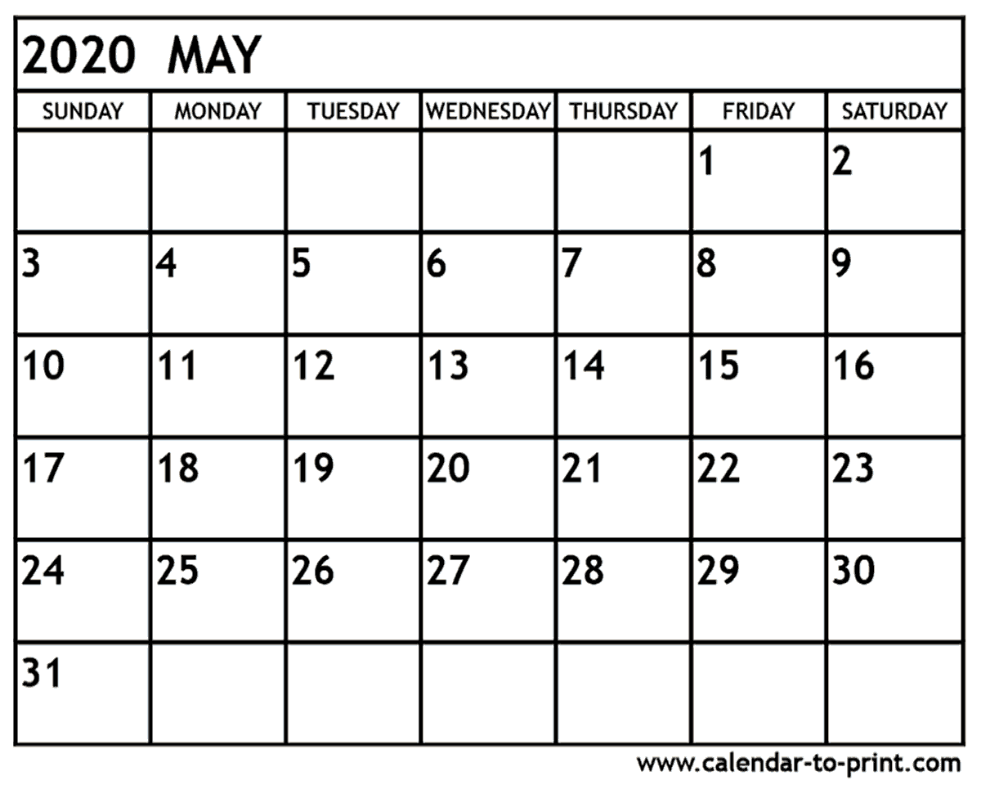
The TEST
The AP Environmental Science Exam will test your understanding of the environmental concepts covered in the course units, as well as your ability to design research studies to solve environmental problems.
Part 1: 60% of test - 80 Multiple Choice (90 min.)
40% Three free response questions (70 min.)
1 Design an investigation
1 Analyze an environmental problem and pose a
solution
1 Analyze an environmental problem and pose a
solution (with calculations)

Slide 11
Math
Basic algebra
Multiplication and long division
Ratios, percentages, scientific notation
Statistical validity
Dimensional analysis
Graphing techniques, such as plotting data on graphs and interpreting and extrapolating data and trends from graphs.

Slide 12
Pass Rate
Year | Score percentages
 | 5 | 4 | 3 | 2 | 1 | Mean | Number of Students
2009 | 10.4% | 20.7% | 18.9% | 18.5% | 31.5% | 2.60 | 73,575
2010 | 10.4% | 22.6% | 17.0% | 18.1% | 32.0% | 2.61 | 86,650
2011 | 8.9% | 24.8% | 15.6% | 24.9% | 25.8% | 2.66 | 98,959
2012 | 8.9% | 24.9% | 16.6% | 24.3% | 25.3% | 2.68 | 108,839
2013 | 8.0% | 23.4% | 16.8% | 25.4% | 26.5% | 2.61 | 118,288
2014 | 8.3% | 23.6% | 15.3% | 25.5% | 27.2% | 2.6 | 130,321
2015 | 7.5% | 24.1% | 15.2% | 25.5% | 27.7%

Slide 13
You can do it!!!

