Slide 1
Warm-up:
“Why do we need to consider safety in a science classroom?”

Slide 2
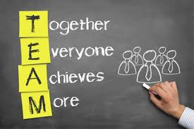
Pyramid Building:
-No touching the cups
-No talking
-Build a pyramid (4 cups on the bottom) using a rubber band and one string per family member
Teamwork!!

Slide 3
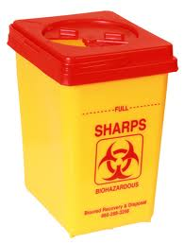
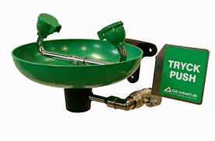
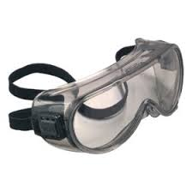
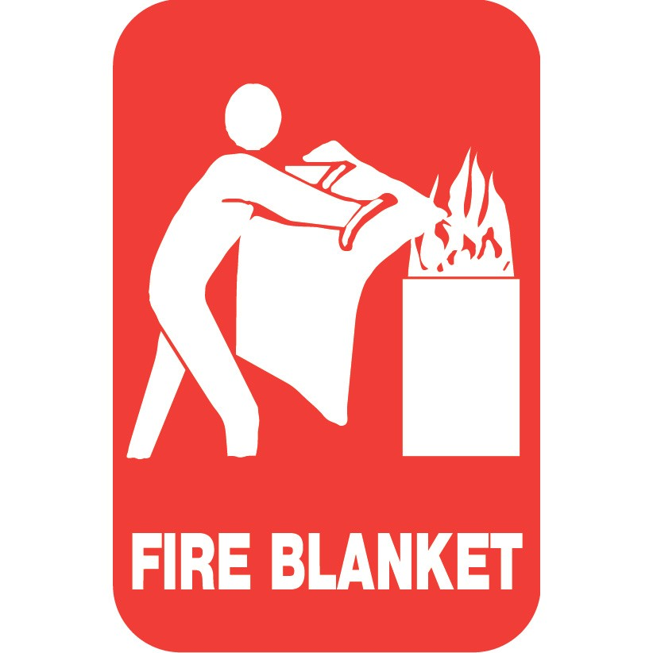
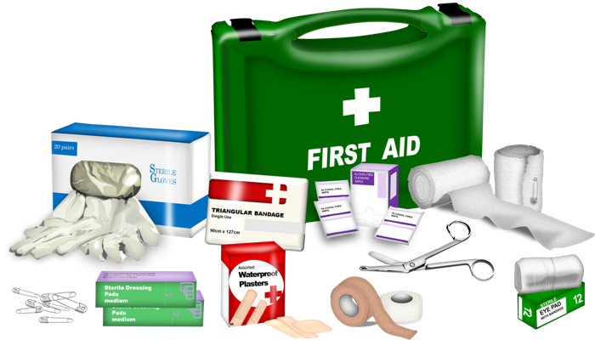
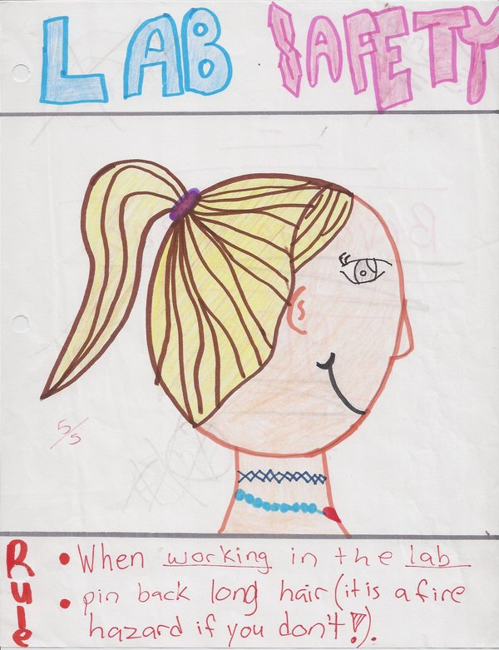
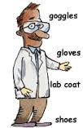
Lab Safety:

Slide 4
Classify (Tree map)
-Group your cups into 3-4 categories under the heading of “lab safety”
-Complete a tree-map using all 10 words
-Write a 2-3 sentence claim explaining your justification for choosing your arrangement.
-Choose a spokesperson to share out.

Slide 5
Reflection:
Choose 3 of the lab safety topics and write a 4-5 sentence justification of why you think they are the most important. Add a sentence explaining how you will stay safe in your biology class.

