Slide 1
Traits (p. 5): Essential Questions: Which traits do you have? Where did you get your traits?
Trait: a distinguishing quality or characteristic

Slide 2
Trait: |  | Rare Or common?
Free earlobes | Attached earlobes
Dimples | No dimples
Hitchhiker’s thumb | No Hitchhiker’s thumb
Widow’s Peak | No Widow’s Peak
Tongue-roller | Non tongue-roller
Taster | Non taster

Slide 3
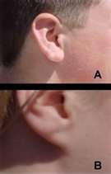
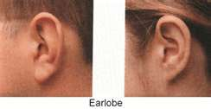
Free or attached earlobes?

Slide 4
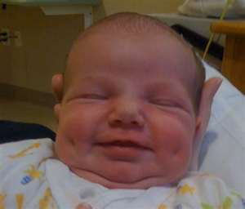
Dimples?

Slide 5
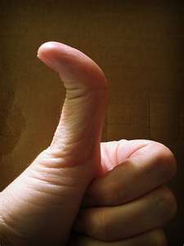
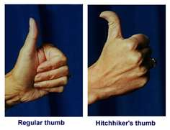
Hitchhiker’s Thumb?

Slide 6
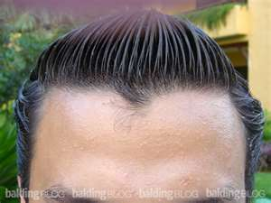
Widow’s Peak

Slide 7
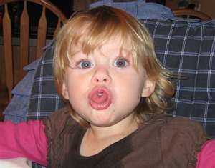
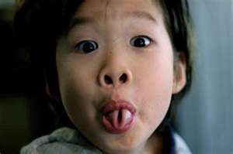
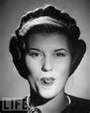
Tongue roller?

Slide 8
Your own traits
Free Earlobes | Attached earlobes | Rare Or common?
Dimples | No dimples
Hitchhiker’s thumb | No Hitchhiker’s thumb
Widow’s Peak | No Widow’s Peak
Tongue-roller | Non tongue-roller
 | Add three more traits either from the video or ones that you know you or other people have.

Slide 9
Summarize (answer the essential questions):
Essential Questions: Which traits do you have? Where did you get your traits?

Slide 10
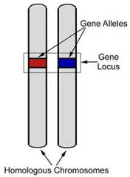
Title page 6 “Genetics Vocab”:
1. Allele: alternative form that a single
gene may have for a particular trait
2. Dominant: A trait that will appear in the offspring if at least one of the parents contributes it. (One dominant allele can “mask” a recessive)
3. Recessive: expressed in offspring only when inherited from both parents, (i.e., when not masked by a dominant characteristic inherited from one parent).

Slide 11
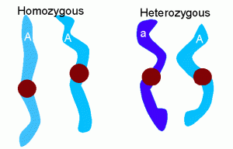
4. Homozygous: Having identical pairs of
genes for any given pair of hereditary characteristics.
5. Heterozygous: Containing two
different alleles for the same trait.

Slide 12
Add to page 6:
6. Genotype: the genetic make-up of an organism
7. Phenotype: the outward expression of a trait

