Slide 1
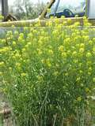
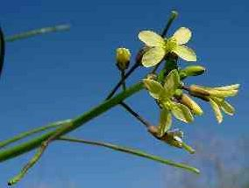
Sahara Mustard – Invasive Species
Would you describe this plant as a decorative flower or a weed?
If you knew that it has few or no natural predators in North America, what concerns might you have about it?
If you learned that Sahara Mustard tends to thrive and crowd other plants out of its habitats, would you consider it a threat to biodiversity? Explain your answer.

