Slide 1
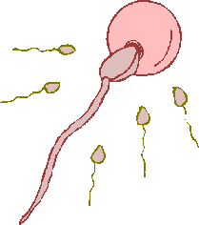
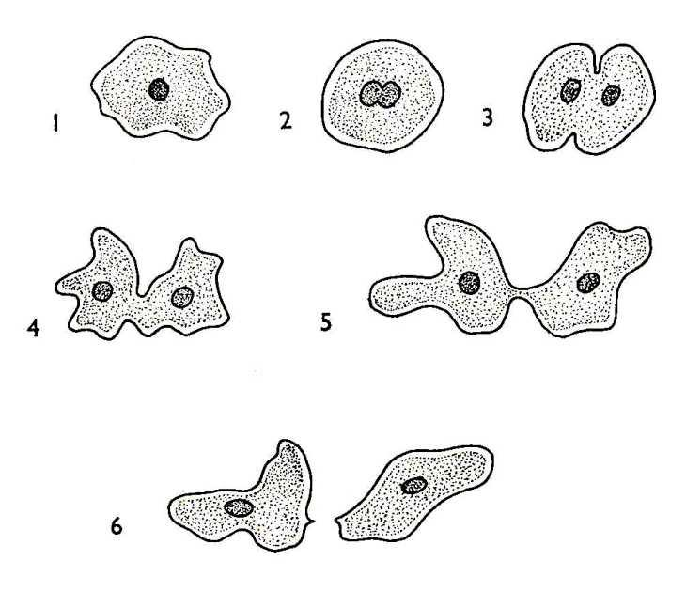
Reproduction
In your notebooks, write and answer (brainstorm) the essential question:
EQ: How are different organisms
adapted for reproduction?

Slide 2
Key Vocabulary:
Asexual Reproduction: Offspring arise from a single organism (copied DNA).
Sexual Reproduction: Production of a new organism from combining genetic material from 2 individuals of opposite gender.
Budding: a new organism arises from cell division at a certain site.
Gametes: (sex cells) eggs, sperm, pollen etc.
Adaptation: Traits that contribute to the fitness or survival of individuals.
Notes:
Interesting note: Prevailing theory of separate genders is that there is a necessity to have different types of gametes (large and small) to avoid all out war between organelles of each individual. Since male gametes are small, the female gamete organelles take over (no battle necessary).

Slide 3
Asexual vs. Sexual Tree Map
Open your envelopes and remove cards
In groups, arrange pictures into categories:
Sexual Reproduction (Both) Asexual Reproduction
External Internal
3. Copy your tree map into your notebook (words only)

Slide 4
Questions:
What are some advantages/disadvantages to external and internal fertilization?
What are 2 possible adaptive advantages to the bristles or spines on some of the penises?
What could be a reproductive advantage of a genital plug?
Why would a long penis give a reproductive advantage to a barnacle?
Summarize the activity (focus on EQ #2)

