Slide 1
Title/Topic: Cell Energy Part 1 (Photosynthesis!) - page 9
Essential Question: What is photosynthesis and why is it important?

Slide 2
Photosynthesis Challenge!!
Collaborate with your group to model photosynthesis with pictures and labels.
Where does photosynthesis take place?
What goes in (reactants)??
What is made (products)??

Slide 3
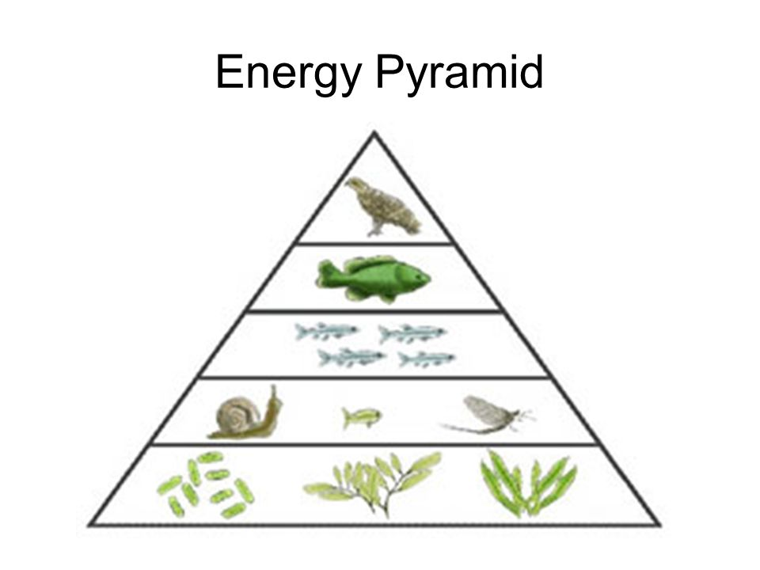
Producers (Autotrophs):
Organisms that can trap the energy from the sun and use it (in organelles called chloroplasts) to drive a chemical reaction to convert Carbon dioxide and Water into Sugar (glucose) and Oxygen.
Plants
Algae
Some bacteria

Slide 4
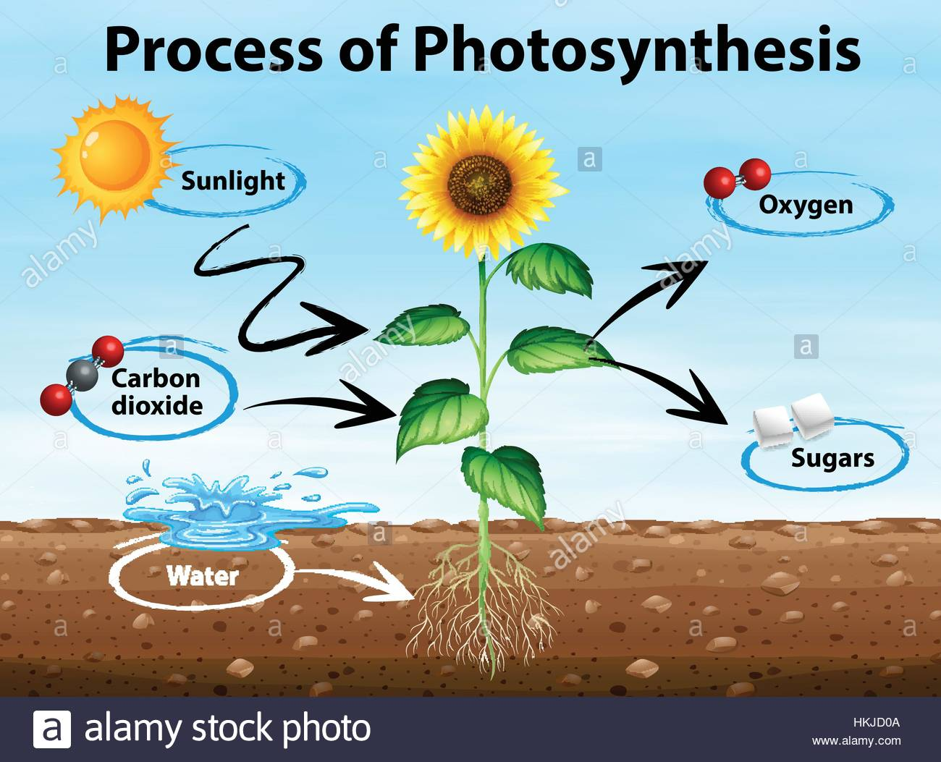
Sketch and Label:

Slide 5
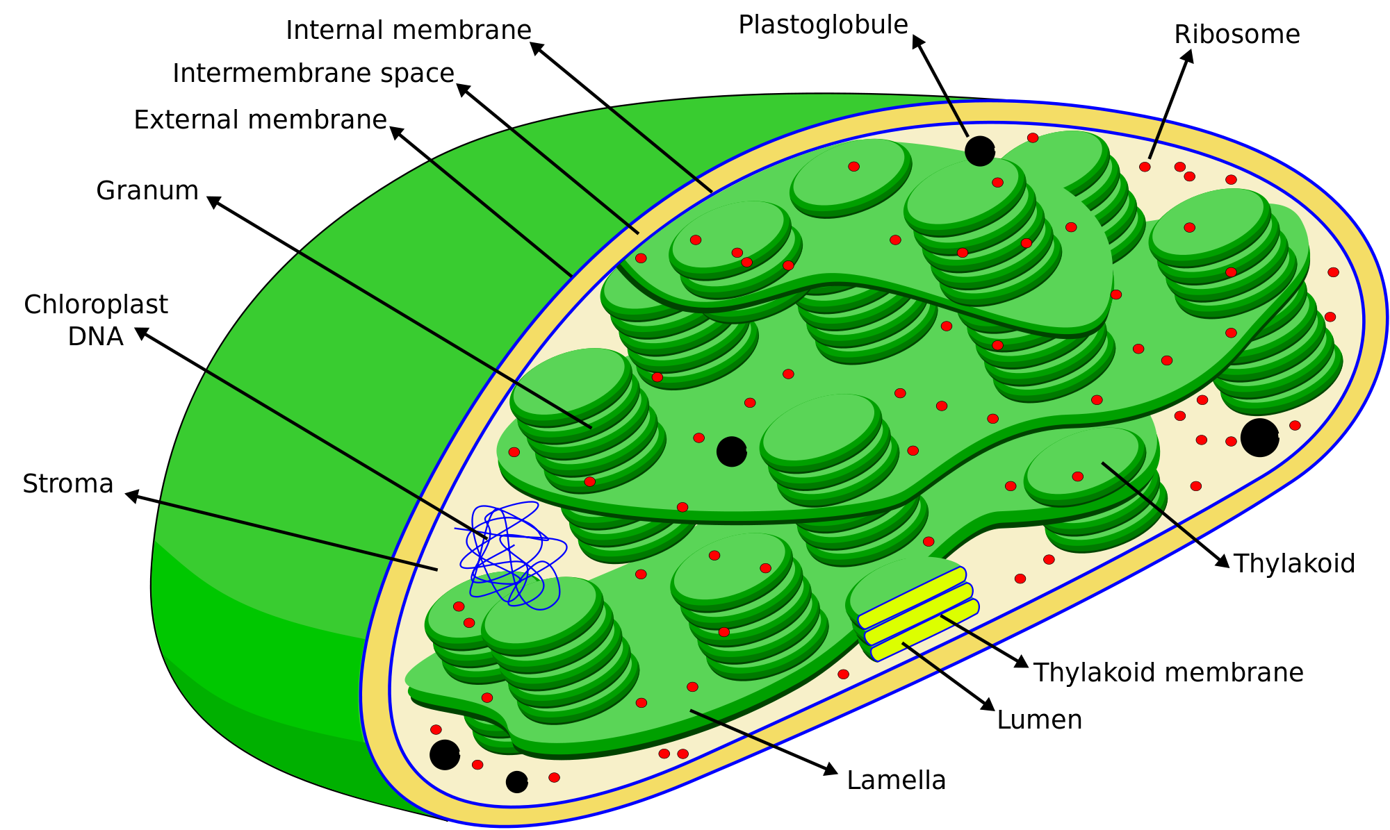
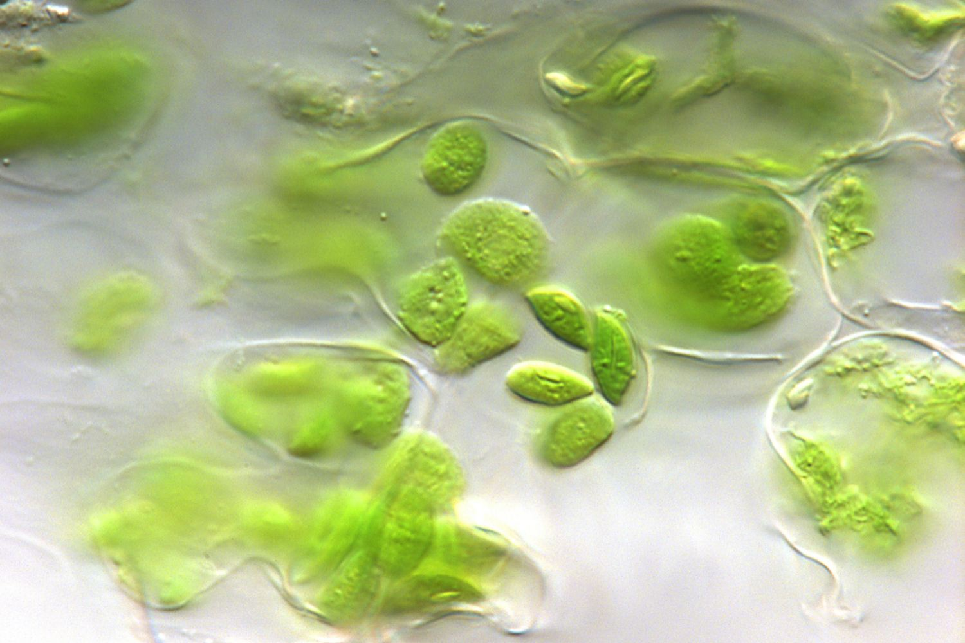
Chloroplasts:

Slide 6
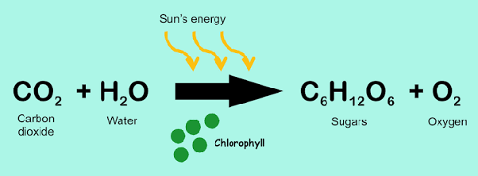
The Photosynthesis Chemical Reaction (write):

Slide 7
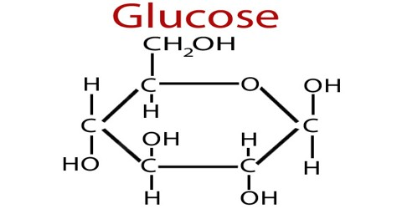
Where does the glucose go?
•Glucose is used in plant cells to make starches
•Plants use transport systems like blood vessels to move starches throughout the plant
•To grow, plants combine carbon that they get from carbon dioxide and glucose to build new tissues
•Plants are consumed by heterotrophs (like us!), who use the starches for their own energy.

Slide 8
Summarize your notes (p.9):
Photosynthesis is:
Photosynthesis is important to plants (and other producers) because:
Photosynthesis is also important to consumers (heterotrophs) because:

Slide 9
Read the “Glucose Article”
Number the paragraphs
Highlight key information
Circle words or ideas that are confusing

Slide 10
Answer the following questions (in complete sentences) on page 10 to check for understanding (by paragraph)
What is glucose used for in plants?
How is the glucose able to get to the plant cells?
In what 2 circumstances will glucose get stored as more complex carbohydrates? (Include the names of the 2 different carbohydrates glucose can be stored as).

Slide 11
Continue on page 10:
4. Why would plants need to make more cells?
5. What is the function of cellulose in the cell wall?
6. What is cellulose made out of?
7. Why is cellulose hard to break down?

Slide 12
P. 11 Photosynthesis “Cut-outs” - add to table of contents.
2. Color the chlorophyll “dot” green
3. Cut out the pieces of the model, place in the correct spots to model photosynthesis - check with your group and your teachers
4. Glue!

Slide 13
Photosynthesis Challenge!!
Collaborate with your group to model photosynthesis with pictures and labels.
Where does photosynthesis take place?
What goes in (reactants)??
What is made (products)??

Slide 14
P. 23 Photosynthesis Model
Cut out the parts and arrange in a way that correctly depicts the process of photosynthesis.
Have us check before you glue
Glue, summarize and study!!

Slide 15
Title/Topic: Cell Energy Part 2 (Cellular Respiration!)
Essential Question: What is cellular respiration and why is it important?

Slide 16
Write down the equation for cellular respiration and think - what do you realize about the components?

Slide 17
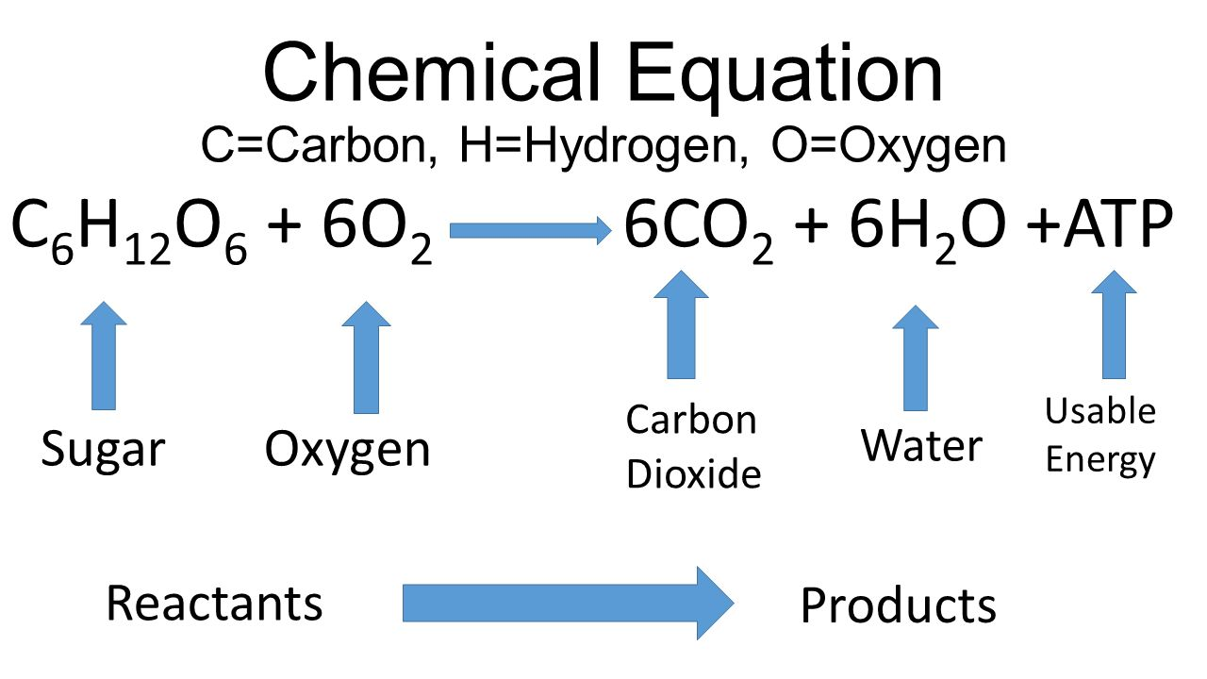

Slide 18
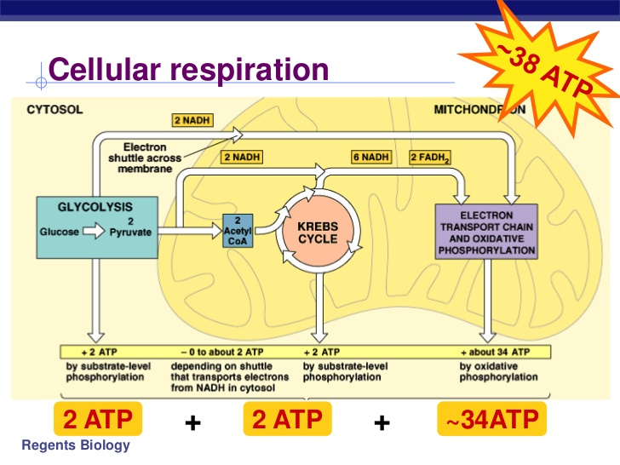
How does
it work?

Slide 19
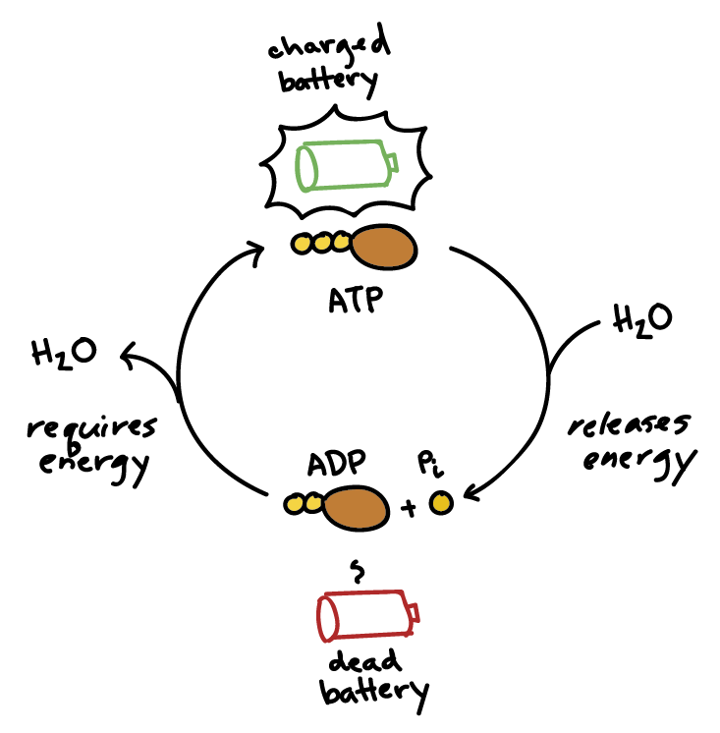
ATP Cycle

Slide 21
Cellular Respiration without oxygen

Slide 22
Summarize your notes:
Cellular Respiration is:
Cellular Respiration is important to all organisms because:

