Slide 1
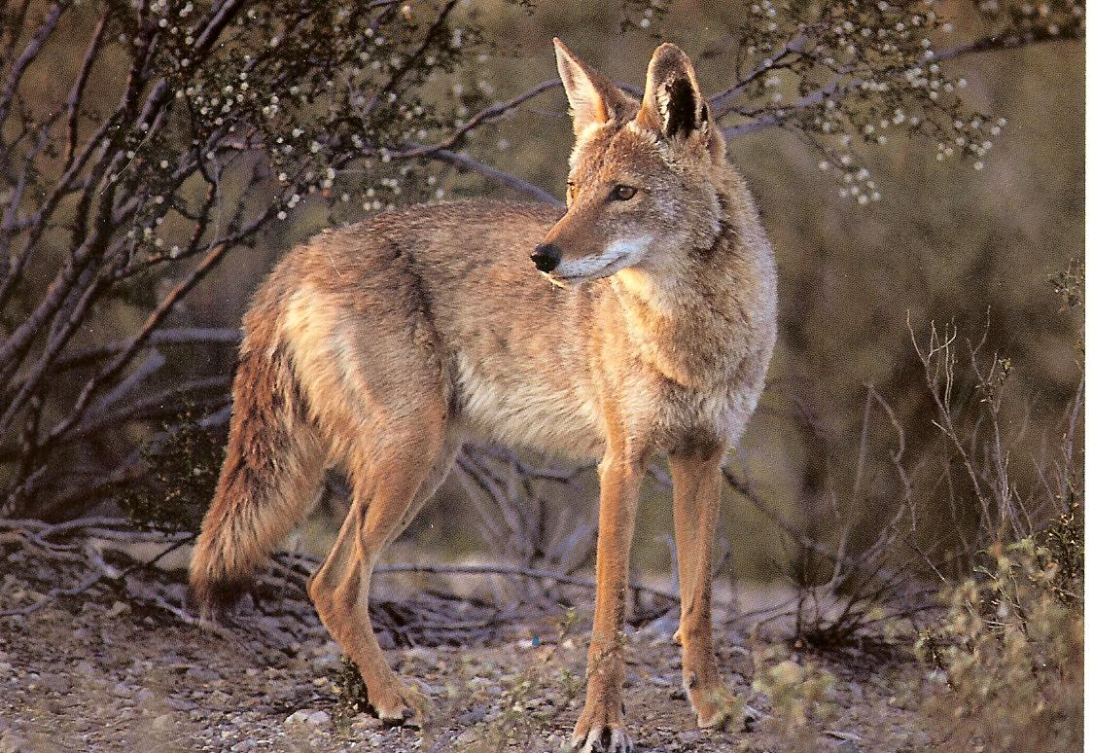
Coyotes either have long legs or short legs. Long legs are the dominant trait. They also have either brown fur or grey fur and brown is the dominant trait.
Cross a Homozygous long-legged, grey coyote with a heterozygous long-legged, homozygous brown coyote. What are the genotypes and phenotypes of their possible pups?

Slide 2
DNA research projects
Mutations or Genetic Engineering

Slide 3
Naming/Sharing:
periodnumberTOPICstudentnames
(Example:1CLONINGbobandcindy)
Share to: srobles@psusd.us (and each other)

Slide 4
Mutations
A mutation is a change in a DNA sequence. Mutations can result from DNA copying mistakes made during cell division, exposure to radiation, exposure to chemicals called mutagens, or infection by viruses. Germ line mutations occur in the eggs and sperm and can be passed on to offspring, while somatic (body cell) mutations are not passed on.

Slide 5
Genetic Engineering
Genetic engineering is the process of manually adding new DNA to an organism. The goal is to add one or more new traits that are not already found in that organism.
Examples: pest resistant crops, human insulin producing bacteria, low-gas producing cows.

Slide 6
Your slide presentation
-Work alone or with a partner
-Research and choose a topic (related to mutations or genetic engineering)
-Report topic to teacher as soon as you decide
-Complete all work for presentations by Friday

Slide 7
Slides
Title with name(s) and period
Background information (history of the topic - when and where was it first discovered or first tested and by whom etc.)?
3 & 4. Information (what is your topic about? What is it? How
does it work or how is it caused? etc.).
*** This part should be at least 2 slides and include at least 1 picture***
5. Reflection slide (what is your opinion? How do you feel about the topic you chose? You and your partner don’t have to agree).
6. Sources (what websites etc. did you use)?

