Slide 1
Plant and animal cells
Microscopes

Slide 2
Cell Theory:
Organisms are made of one or more cells
Cells are the basic unit of life
All cells come from other cells

Slide 3
Definitions:
Cell (plasma) membrane: Flexible, selectively permeable boundary that helps control what enters and leaves the cell
Cytoplasm: semifluid material inside the cell’s plasma membrane
Nucleus: central organelle the manages the cellular functions and contains DNA
Organelle: Specialized internal cell structure that carries out specific cell functions

Slide 4
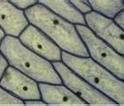
Low Power
1. Does this show plant cells or animal cells?
2. What do you expect to see differently at higher power?

Slide 5
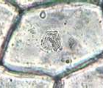
High Power
3. Why do you think the edge of the cell looks thick?

Slide 6
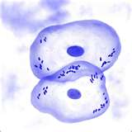
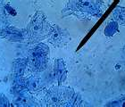
4. Based on the lab – what do you think these show?
5. Are they plant or animal cells?
6. Which organelle is visible?

