Slide 1
Patterns of Inheritance
Mendel and his laws!

Slide 2
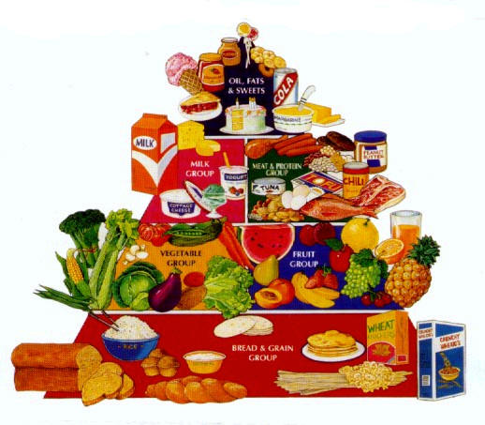

Hit or Myth?
Taste is inherited (Fact or Fiction)
FACT! Your ability to taste certain flavors is inherited. Your taste in style, clothing, music is NOT inherited!

Slide 3
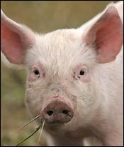
Hit or Myth?
You may someday get body parts from a pig.
FACT! Scientists are working to breed pigs with organs that can safely be transplanted into humans. These organs will not carry disease.

Slide 4
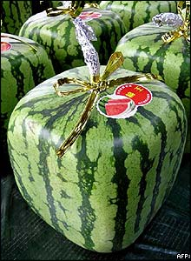
Hit or Myth?
You can grow a square watermelon.
FICTION! Scientists are working to produce fruits and veggies that are easier to stack.

Slide 5
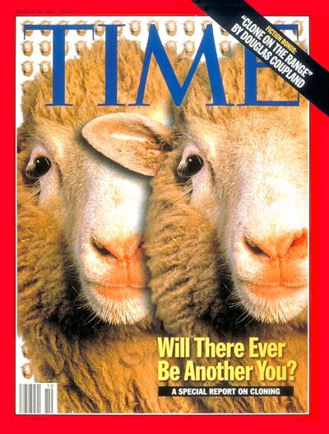
Hit or Myth?
Clones exist only in science fiction.
FICTION! There have been sheep cloned through the means of genetic engineering techniques. Their genes are exactly alike!

Slide 6
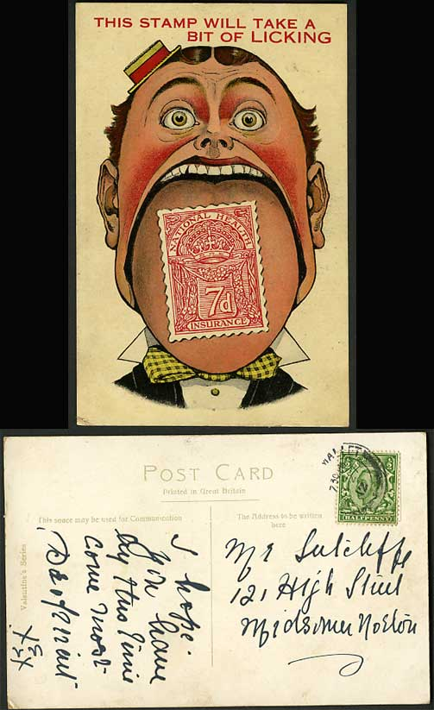
Hit or Myth?
When you lick a stamp, you leave behind enough information to be identified.
FACT! Like all the cells in your body, saliva cells contain genetic information from cells in your mouth!

Slide 7
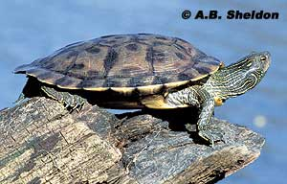
Hit or Myth?
In ALL organisms, sex is determined by genetics.
FICTION! The sex of the map turtle is influenced by the eggs’ incubation temperature. The hotter the temperature the greater % of female offspring.

Slide 8
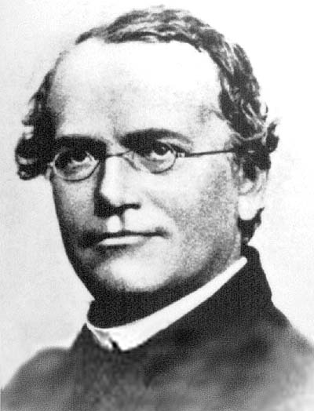
Gregor Mendel
Father of genetics
1860’s
Applied mathematics to support his observations.

Slide 9
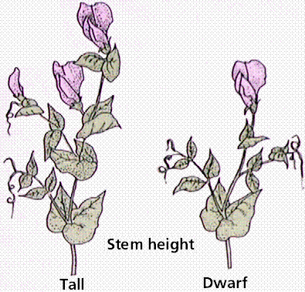
Pea Plant
Chose the pea plant to study inheritance:
  Structure of the pea flowers
  Presence of distinctive traits
  Rapid reproduction cycle

Slide 10
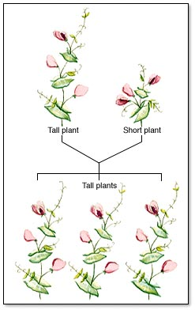
Pea Plant
Mendel was able to isolate and control variables.
The controlled variable was Fertilization!

Slide 11
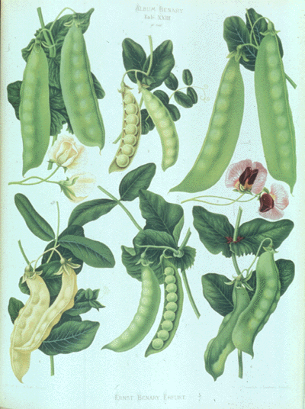
Studied 7 Traits: Traits that were easy to see!
Color: yellow or green (pea, pod, and flower)
Height: tall or short
Flower position: axial or terminal
Shape: round or wrinkled (pea) or inflated or constricted (pod)

Slide 12

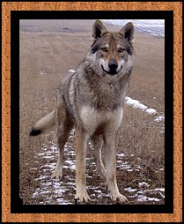
Purebred vs. Hybrid
Purebred: organism that receives the same genetic traits from both its parents.
Hybrid: Organism that receives different forms of a genetic trait from each parent.

Slide 13
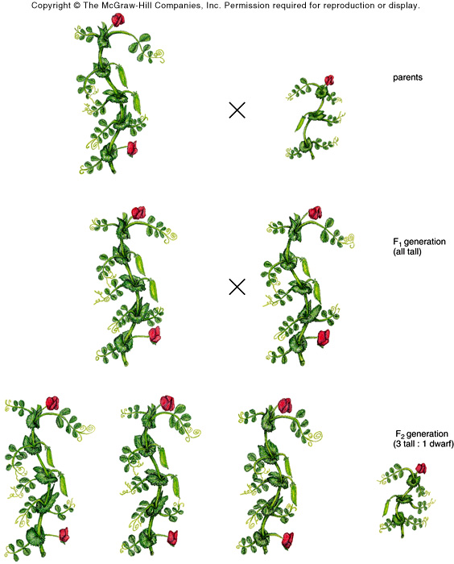
Mendel’s Work
First used purebred plants (2 different groups)
This produced the Parental generation or (P) Generation.
Purebred Tall x Purebred Short

Slide 14
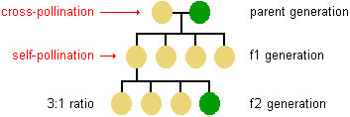
Mendel’s Work
Offspring from the (P) generation were then crossed to get the first generation offspring (F₁) = Filial generation.

Slide 15

Mendel’s Work
Self fertilized the F₁ generation to now get the F₂ generation. (Second generation)

Slide 16

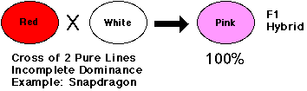
Blending Theory put to rest!
Blending theory said that there would be a chartreuse colored pea in the F₁ generation.
This was NOT the case!
Found all yellow plants and NO green!

Slide 17
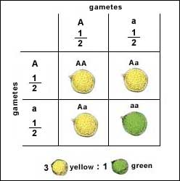
F₂ Generation Surprise!
In the F₂ generation Gregor found green peas.
This was the ratio:
  75% were yellow
  25% were green
  Ratio was 3:1
  No chartreuse peas!

Slide 18
Mendel Video
Mendel’s Video

Slide 19
Mendel’s Laws
Law of Segregation: Gene pairs separate when gametes form.
Each gene pair segregates or separates during meiosis.
½ of the organism’s gametes contain one gene from a homologous pair and the other ½ of the gametes contain the other gene.

Slide 20
Mendel’s Laws
Law of Independent Assortment:
  2 traits studied at the same time
  Traits are inherited independently
  States that gene pairs segregate into gametes randomly and independently of each other.

Slide 21
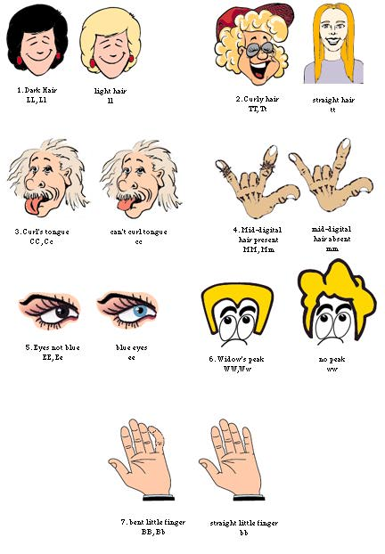
Mendel’s Laws
Law of Dominance: Dominant allele is expressed and recessive allele is hidden.

