Slide 1
Warm-up:
Brainstorm: how do you think diseases are spread?

Slide 2
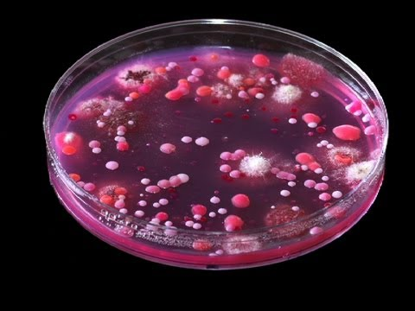
Infectious Diseases
Infectious diseases are caused by pathogenic microorganisms such as bacteria, viruses, parasites or fungi: the diseases can be spread, directly or indirectly, from one person to another (or with zoonotic diseases from animal to person). WHO

Slide 3
Modes of transmission:
Direct (kissing, sex, bites): e.g.: “mono”, HIV, herpes
Indirect (drinking cups, toys, toothbrushes etc.): e.g.: flu
Airborne (coughing, sneezing, aerosols etc.): e.g.: flu, TB
Vector-borne (mosquitoes, ticks, fleas etc.): e.g.: malaria
Waterborne (pools, streams etc. ): e.g.: cholera, giardia
Foodborne (chicken, seafood etc.): e.g.: food poisoning, tapeworms
Fecal-oral (poor hand washing etc.): e.g. polio, typhoid, E. coli

Slide 4
Team Research Presentations
Read and highlight or underline the information you are given and use your Chromebooks to create a whiteboard presentation.
Include the following information:
Name of disease d. Treatment
Mode of transmission e. Picture/sketch
Symptoms f. Interesting fact

Slide 5
Disease | Transmission | Symptoms | Treatment Interesting Fact
1.Rabies
2. Smallpox
3. Influenza
4. Tuberculosis (TB)
5. Anthrax
6. Cholera
7. Bubonic Plague
8. Ebola
9. MRSA

Slide 6
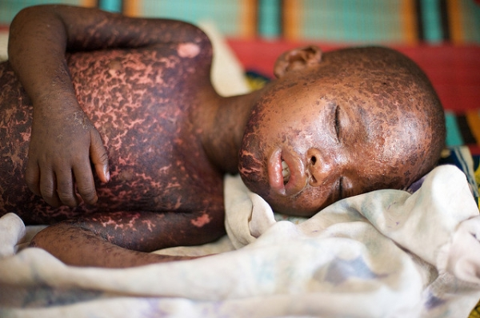
Analysis
What are some factors that you think might contribute to the spread of infectious diseases?
Why do you think some diseases like measles that had been “eradicated” by vaccines have made a comeback?

