Slide 1
Human Body Systems
How do the different systems work together to maintain homeostasis?

Slide 2
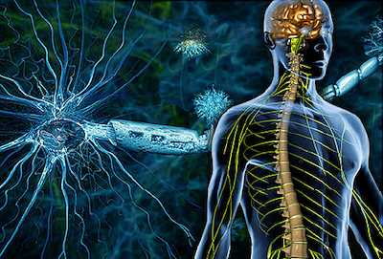
Nervous System
How does the nervous system help to maintain homeostasis?

Slide 3
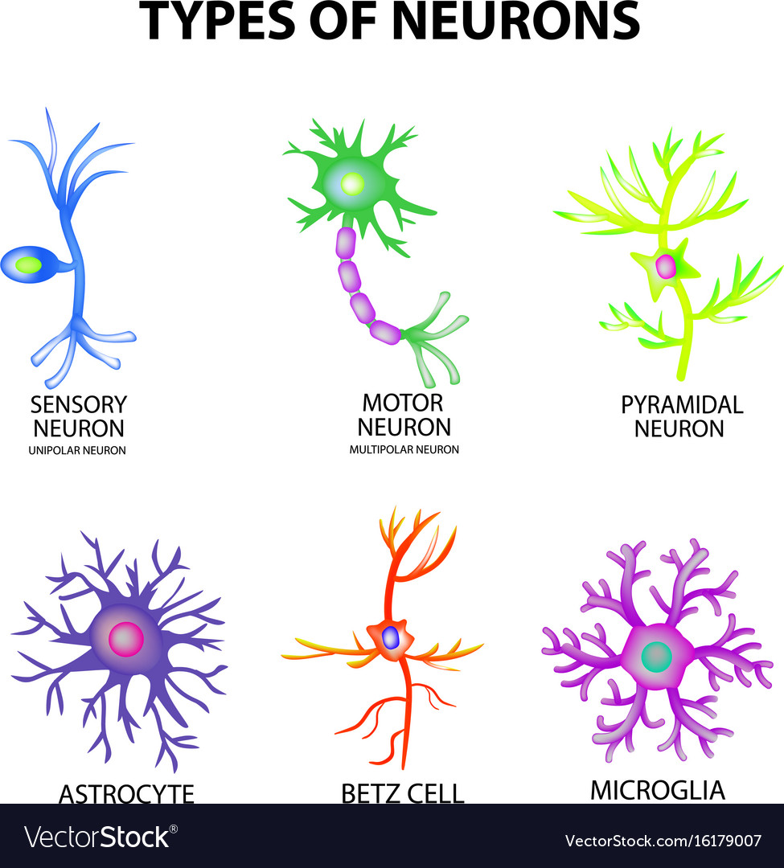
The nervous system coordinates its actions by transmitting signals to and from different parts of its body.
It detects environmental
changes that
impact the body.

Slide 4
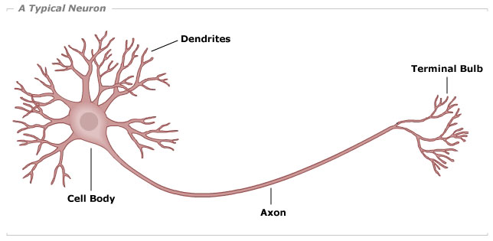
Draw
Draw and label the neuron:

Slide 6
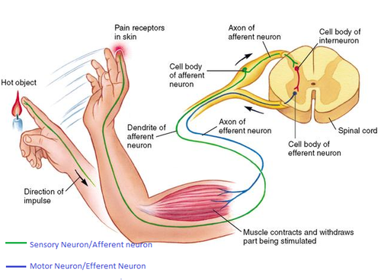
Reflex Arc - what’s missing??

Slide 7
Write your name on the video guide “Wired,” Fill in the missing words as the video plays and attach the completed paper to page 10 in your notebook.

Slide 8
Stroop Tests
In psychology, the Stroop effect is a demonstration of interference in the reaction time of a task. The most well known Stroop test is the color test where….
.

Slide 9
Naming the colors of the top 2 rows will probably be faster than naming the colors of the rest.

Slide 10
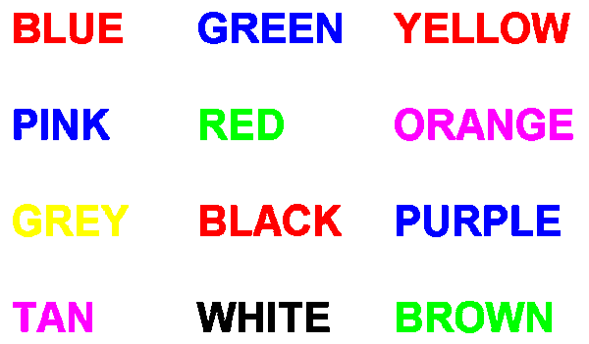
SAY THE COLOR OF THE INK (NOT THE WORD)
Use the cards and the timer on your phone to time your partner. Write your time in the margin of your notes.

Slide 11
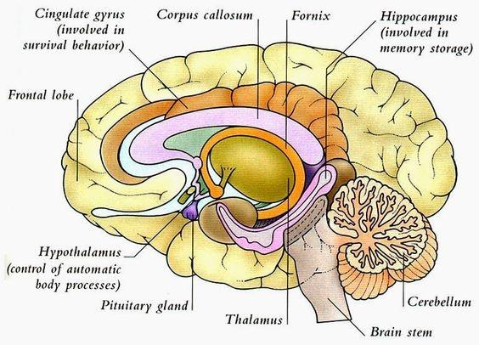
Summarize your nervous system notes by answering the essential question, “How does the nervous system help to maintain homeostasis?

Slide 12
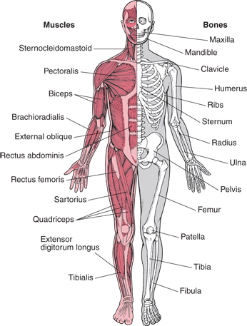
EQ: How does it help to
maintain homeostasis?
Musculoskeletal System

Slide 13
Provides form, support, stability and movement to the body.
Made up of bones, muscles, cartilage, tendons, ligaments, joints, and other connective tissue that supports and binds tissues and organs together.

Slide 14
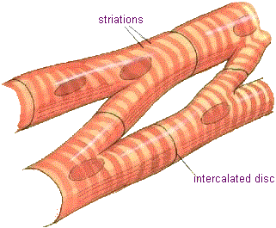
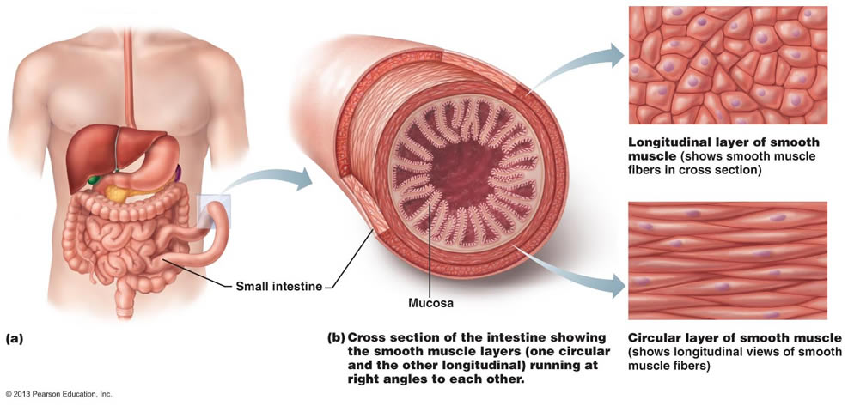
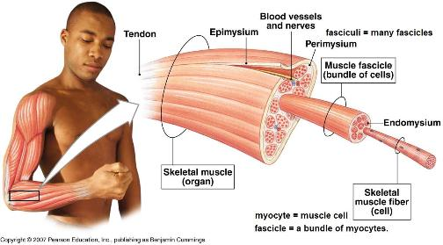
Three types of muscle tissues:
Cardiac muscle: specific to the heart
Smooth muscle:
(internal organs)
Skeletal muscle: voluntary - you are in charge of its movement.

Slide 15
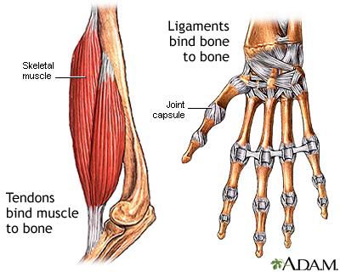
Your skeletal system is all the bones of the body and the connective tissues.
(Your teeth are also considered part of your skeletal system although they are made of dentin and enamel and not bone).

Slide 16
Watch the video and think about homeostasis.

Slide 17
Summarize your notes
(answer the essential question - How does the musculoskeletal system help to maintain homeostasis?).
Notes:
4 videos

Slide 18
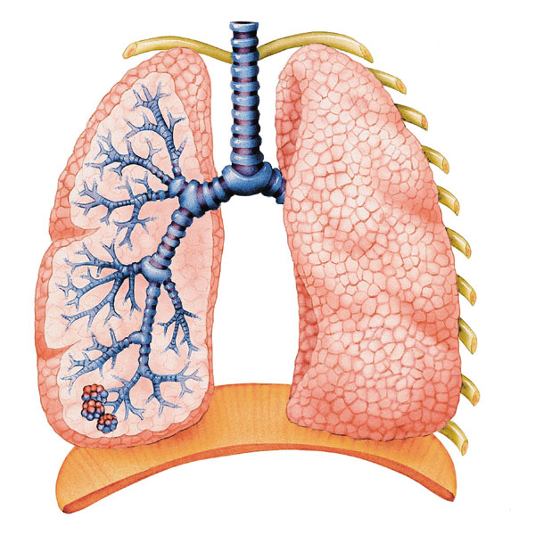
Respiratory System
EQ: How does this system help the body maintain homeostasis?
Lungs: main organ
Gas exchange takes
place in the lungs (Oxygen
in / Carbon Dioxide out).

Slide 19
You will use balloons to measure your vital lung capacity (capacity of air breathed out in one breath).
Follow instructions and turn the completed paper in for a lab grade. You will throw your balloon away at the end of lab.

Slide 20
Brainstorm, Discuss and Share out:
How does gas exchange relate to homeostasis?
What would happen if the cells in the body do not receive enough oxygen?
What would happen if the body builds up too much CO₂?

Slide 21
Notes:
http://www.buzzle.com/images/diagrams/human-body/respiratory-system-diagram.jpg

Slide 22
Fun Fact:
The Lungs consist of over 300,000 million capillaries which are tiny blood vessels. If they were laid out, they would span 1,500 miles!
Question to challenge you: Why do you think the lungs have such a high number of capillaries? (Hint: The walls of the capillaries are very thin).
Notes:
Grocery store cart size analogy Intro: https://animoto.com/play/glD8vjuNvCQ4YBa8jhIOqA

Slide 23
Respiratory Notes Summary:
Summarize your notes by answering the essential question:
“How does the respiratory system function to maintain homeostasis?”

Slide 24
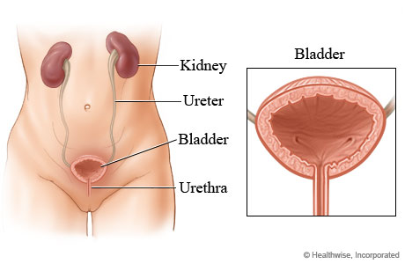
Excretory System
Removes excess, unnecessary materials from the body fluids.
Essential Question:
How does the excretory
system help to maintain homeostasis?

Slide 25
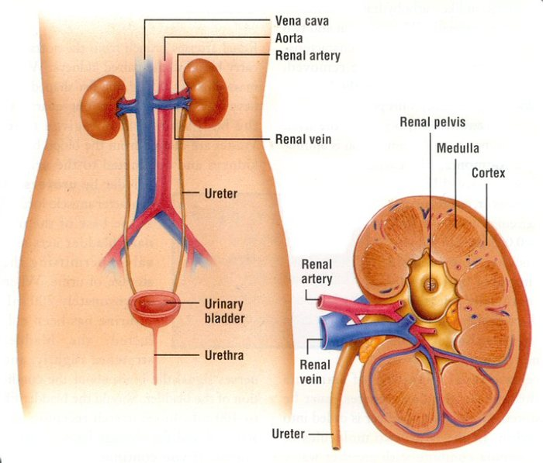
What is this organ?
What does it do?
How does that relate to homeostasis?

Slide 26
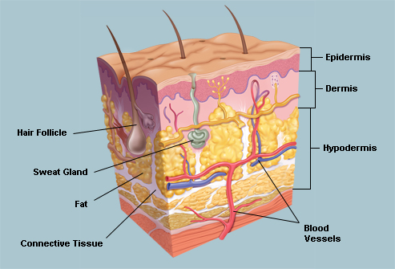
The lungs and skin are also excretory organs.
Why do you think the lungs
are considered an excretory
organ?
What does the skin excrete?
How does this excretion of
wastes help to maintain
homeostasis?

Slide 27
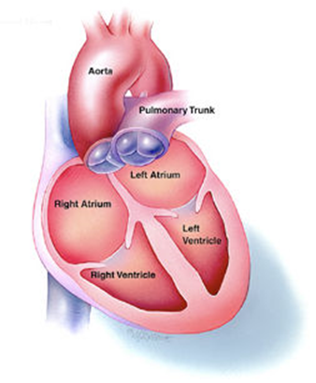
Circulatory System*
Heart
Blood
Blood vessels (veins,
arteries and capillaries)
(*FYI,our blood is NOT blue)!

Slide 28
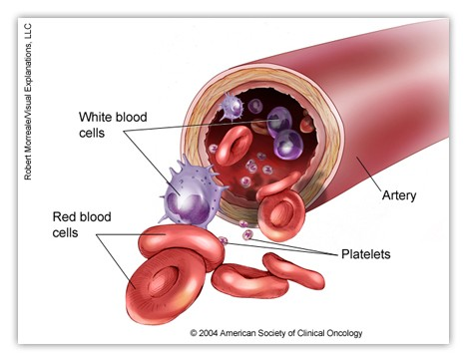
Blood
The body contains
about 5 L of blood.
Red blood cells, most
white blood cells, and
platelets are produced
inside the bone marrow.
Red blood cells have the protein hemoglobin that attaches to oxygen.
White blood cells fight infections.

Slide 29
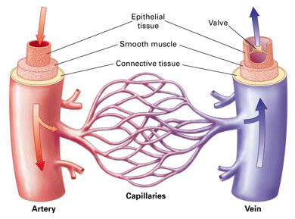
What other body systems might work closely with the circulatory system?

Slide 30
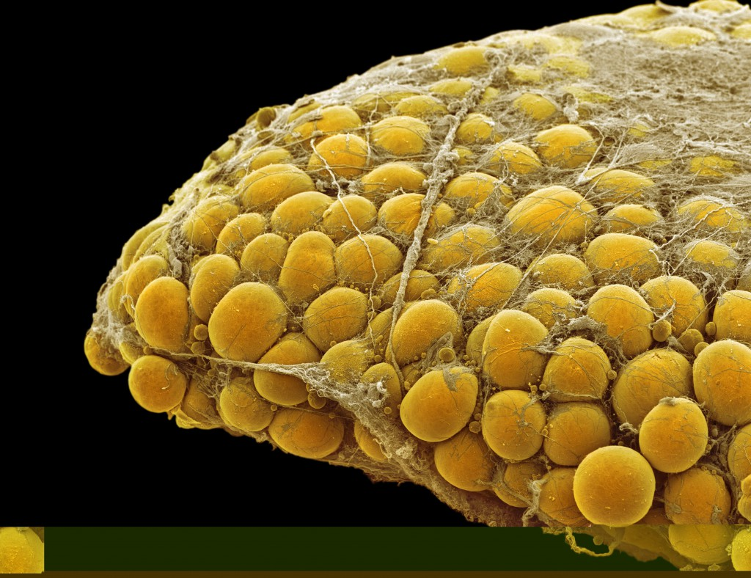
Fun Fact:
7 new miles of blood vessels are made for
every 1 pound of fat gained!
1 pound = 7 miles!

Slide 31
“Blood Color” Article Activity
Number the paragraphs
Read the article
Circle any confusing words
Complete the following tree-map:

Slide 32
“Blood Color” Article Tree Map:
Octopus Human Icefish (GB) Skink
(blood color) (blood color) (blood color) (blood color)
Explanation Explanation Explanation Explanation
(Do all explanations in complete sentences. How/Why do they have the color of blood that they do)?

Slide 33
Analysis
No matter the color of their blood, all of the organisms mentioned in the article need blood. According to the article, what is the main purpose of blood and how does it relate to maintaining homeostasis?

Slide 34
Digestive System
The digestive system breaks down food so nutrients can be absorbed by the body.
Digestion can be mechanical or chemical.
Most nutrients are absorbed in the small intestine.
Accessory organs provide enzymes and bile to aid digestion.
Water is absorbed in the colon.

Slide 35
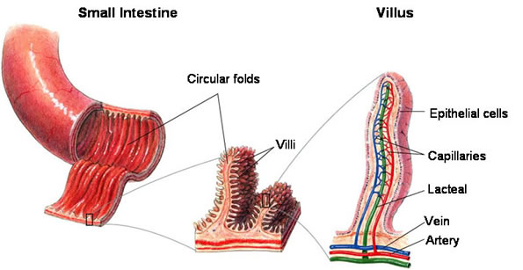
Where do nutrients (and water) go after they’re absorbed through the intestines?

Slide 36
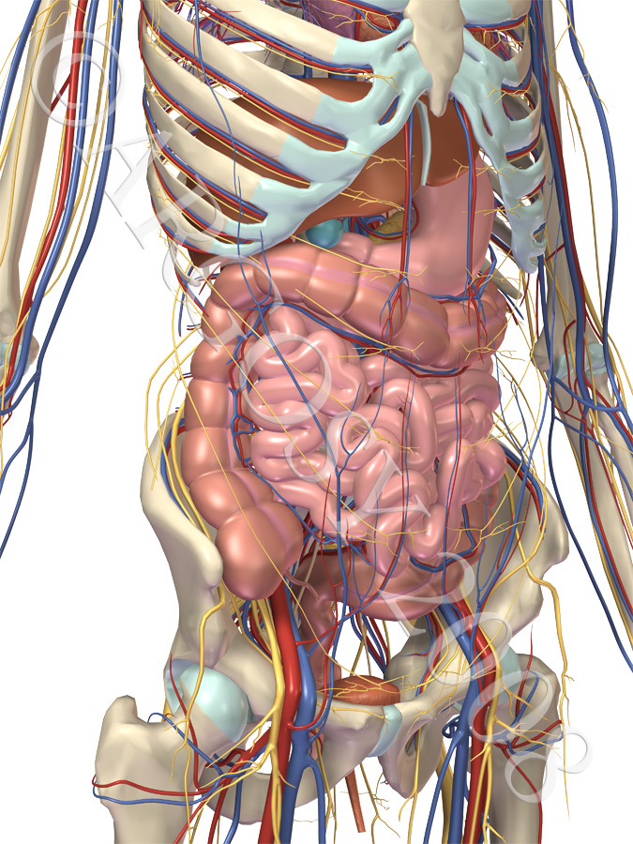
Why would the circulatory
system interact with the digestive system?

Slide 37
Blood has the ability to reach every cell in the body and bring them what they need, including essential nutrients and water. Without these, the cells would die.

Slide 38
What does the digestive system absorb?
Carbohydrates
Proteins
Fats
Minerals like Sodium (Na⁺), Calcium (Ca⁺²) and others.
Vitamins like vitamin A and vitamin C
Water

Slide 39
How does the body use energy?
10% goes towards digestion.
20% goes towards voluntary movement
70% goes towards general body functions (working with the other body systems).

Slide 40
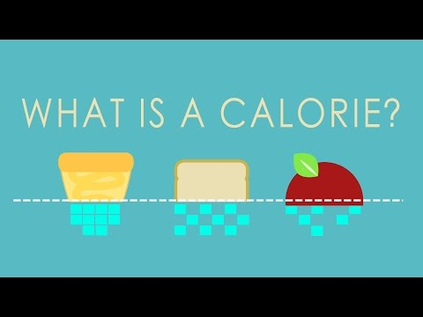

Slide 41
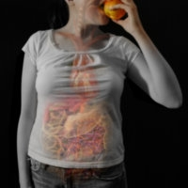
Digestive System Matching
-Collaborate with your group and
match the digestive organs to
their functions.
-Use your reasoning skills and tell me when you’re ready to be checked.
-Extra challenge - place the pairing in the order the food would travel!
-Don’t open the envelope until I say GO!

Slide 42
Digestive system matching
-Once you have the organs correctly paired with their functions, write the pairings in your notebook.
-Add a summary explaining how all of the parts work together to help maintain homeostasis.

Slide 43
Reproductive System
Allows humans to make more humans (continue the species and pass on genes).
Female Reproduction:
Ova: female reproductive cells (eggs)
Ovaries: female sex glands that house and produce the eggs and estrogen.
Estrogen: female sex hormone

Slide 44
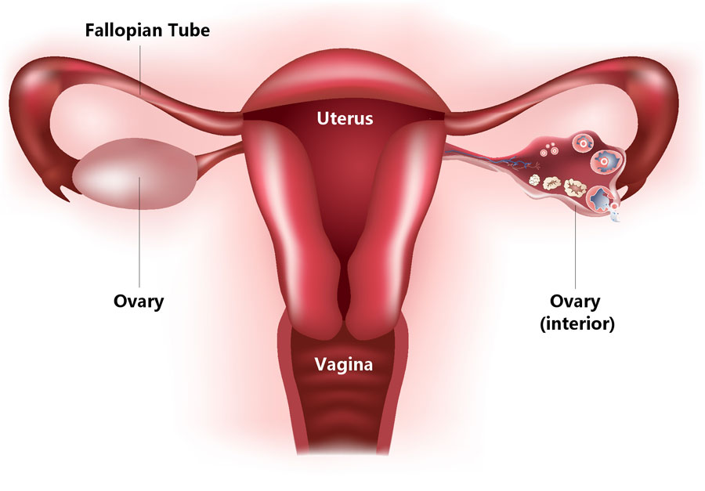
Vagina: Passageway that
extends from the uterus
to the outside of the body.
Fallopian Tubes: pair of tubes that draw the ovum in. Lined with cilia to help move the ovum along.
Uterus: small, muscular organ where the zygote travels to and where the fetus grows.

Slide 45
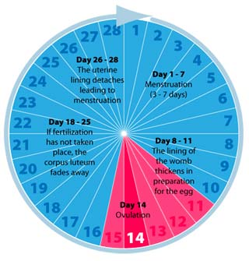
Menstruation
The uterus
prepares for
pregnancy.

Slide 46
Male reproductive organs:
Testicles (Testes): 2 small glands that produce sperm
Scrotum: Maintains the temperature for sperm production.
Penis:external organ specialized to deliver sperm but also urine.

Slide 47
Seminal Vesicles: Glands that produce a fluid that contains nutrients for the sperm
Prostate Gland: Secretions from here also mix with sperm for mobility.
Cowper’s Gland: Produces an alkaline fluid that neutralizes the semen.
Urethra: Passageway through which sperm and urine leave the body.

Slide 48
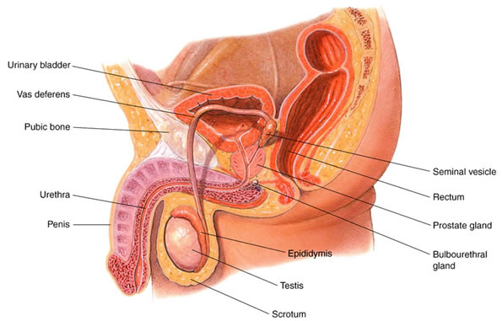

Slide 49
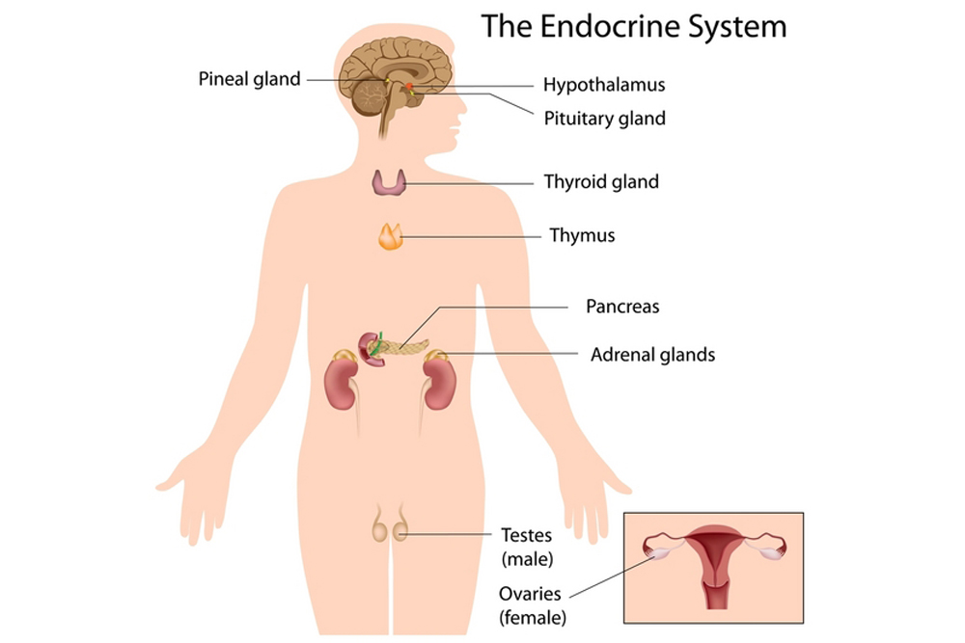
Endocrine System

Slide 50
Endocrine System
Collection of glands that secrete hormones into the circulatory system to be carried to distant target organs.
Major endocrine glands: Pineal gland, pituitary gland, pancreas, ovaries, testes, thyroid gland, parathyroid gland, hypothalamus, gastrointestinal tract and adrenal glands.

Slide 51
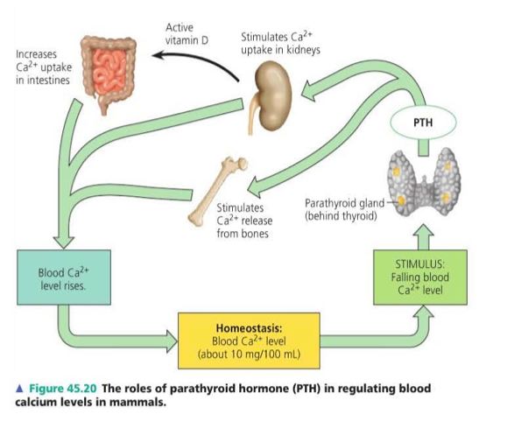
Feedback loop:
-How does
the
endocrine
system
maintain
homeostasis?

Slide 52
Think about all of the body systems:
How do the body systems work together?
How do the body systems relate to the characteristics of life?
How do the body systems maintain homeostasis?

