Slide 1
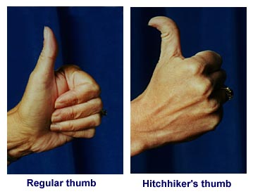
Assume hitchhiker’s thumb is dominant
A man who is heterozygous for hitchhiker’s thumb, marries a woman who does not have hitchhiker’s thumb. Is it possible for them to have a child with a hitchhiker’s thumb? If it is possible, how probable is it?
[Use a Punnett square to defend
your answer.]

