Slide 1
Henrietta Lacks

Slide 2
Article Analysis:
Read the article once as a class
Number the paragraphs
Highlight or underline anything that captured your attention.

Slide 3
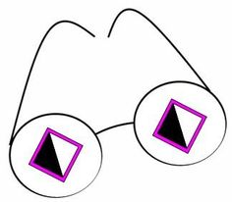
Whiteboard Activity:
Your group will receive an example of a “gene therapy success”
Read your example as a group and create a quick presentation of the main ideas on a separate sheet of paper (10 minutes)
Share out your information to the class

Slide 4
Reflection :
What are your feelings about scientists using Henrietta Lack’s genes without her permission? Are their actions justified by the medical progress that has come from the results? Express your thoughts in a paragraph using complete sentences and academic language.

