Slide 1
Molecule Models
November 13, 2017

Slide 2
Plants and Photosynthesis
EQ: How do plants use photosynthesis to create a source of macromolecules for themselves and other organisms?

Slide 3
Recap:
We know that plants need:
CO₂+H₂O + Sunlight
To make something that can be used for macromolecules

Slide 4
Let’s start with some ingredients
Make this key in your notes:
= Hydrogen
= Carbon
= Oxygen

Slide 5
For your table get:
6 black carbons
18 red oxygens
12 green or white (or both) hydrogens
24 “long” grey “bonds”
12 “short” grey “bonds”

Slide 6
Time to make the ingredients!
Draw 6 each of these in your notes, and make 6 of each them using the model components:
Water H₂O
Carbon Dioxide CO₂

Slide 7
We add some sunlight!!!

Slide 8
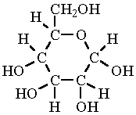
Now take your water and carbon dioxide
And make this!

Slide 9
Draw this!
This is Glucose!!
It’s what plants make!

Slide 10
But what was left over?

Slide 11
OXYGEN!!!
Take your leftover oxygens and make as many of these as you can! Also draw this in your notes!

Slide 12
The full equation!!!

Slide 13
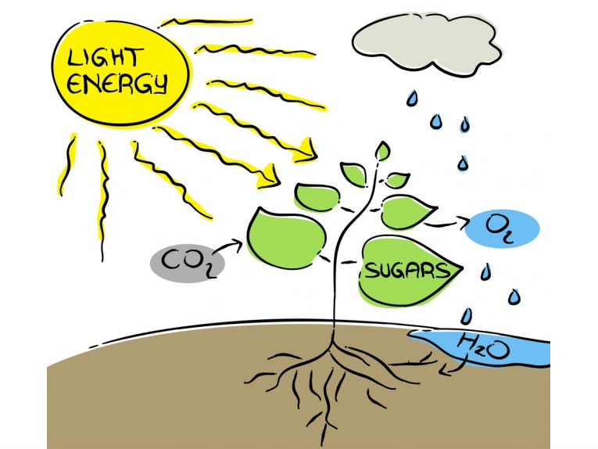
Plants are producers
Plants are unique in that they can make their own source of energy using sunlight.

Slide 14
Energy
Energy is the ability to do work or grow
Cells in organisms need energy in order to do their jobs
All Energy on the earth originates from the sun

Slide 15
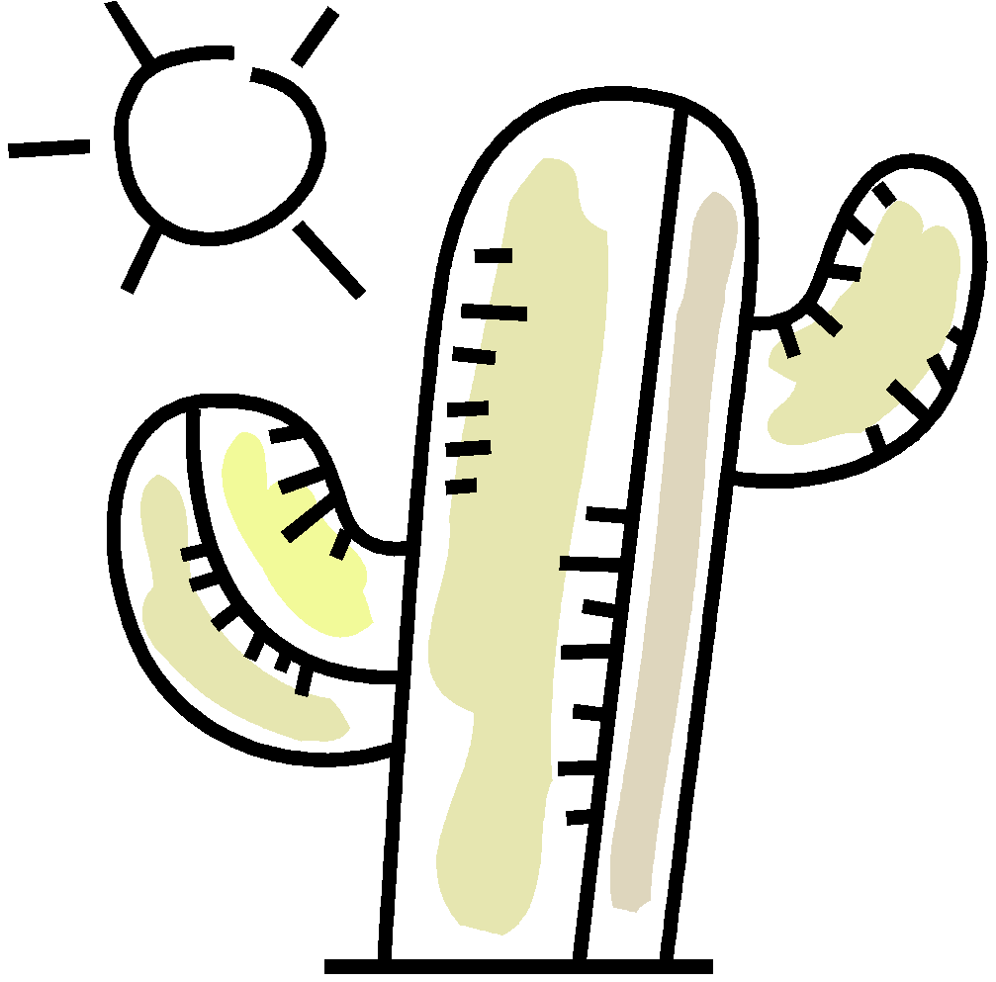
Photosynthesis
Photosynthesis is the process plants use to capture that energy for themselves
Photosynthesis uses the energy from the sun to make glucose and takes carbon
from the air (CO₂) to use for
growth

Slide 16
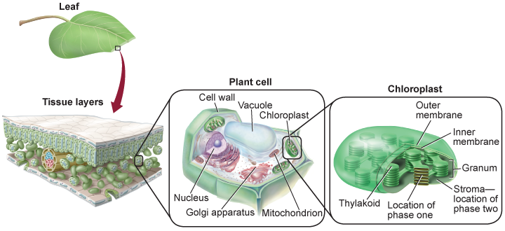
Photosynthesis takes place in the chloroplasts of plant cells.
Chloroplasts contain the pigment chlorophyll which absorbs certain wavelengths of light energy. Chlorophyll is what makes plant leaves and the stems of plants green.

Slide 17
Warm-up (Glucose) Name__________________ Period____
What is the purpose of photosynthesis?
What is the purpose of cellular respiration?
What does a plant need in order to grow (what ingredients)?
Think about the structure of glucose – What would need to happen in order to make it into proteins and lipids?
What percent of available energy would a snake get that eats a mouse that eats seeds?

Slide 18
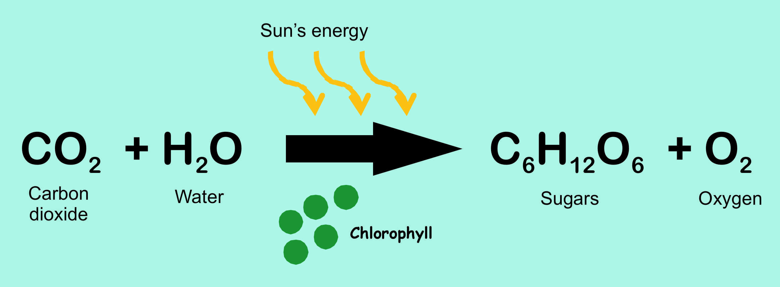
The Photosynthesis Reaction
Carbon Dioxide and water combine in the presence of sunlight to make glucose (a sugar) and oxygen gas.

Slide 19
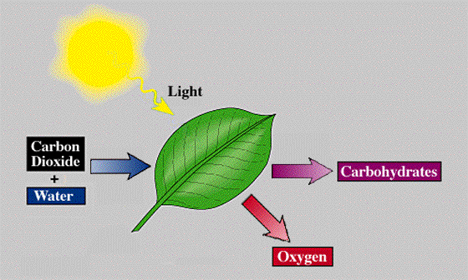
The chlorophyll catches the energy from the sun so that it can be used to make glucose.

Slide 20
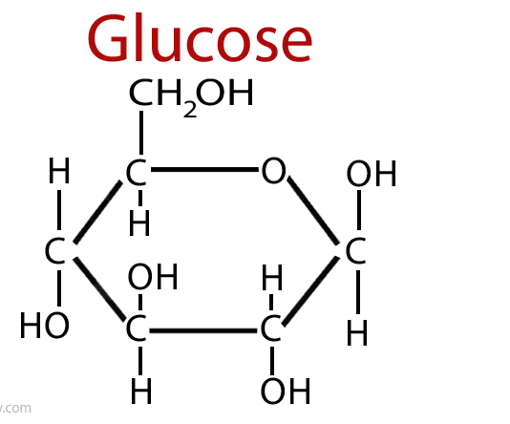
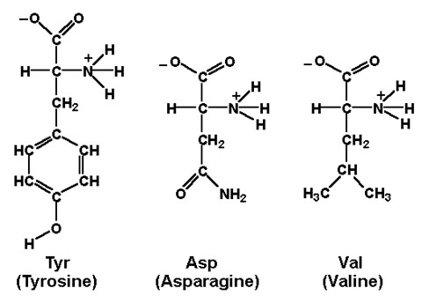
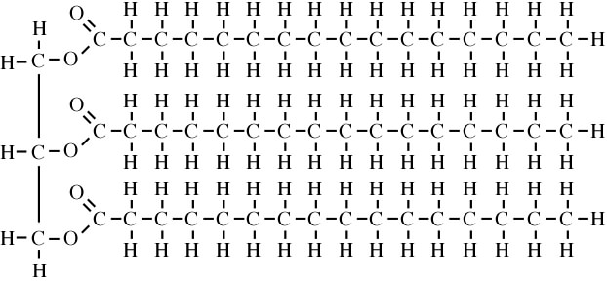
Why would glucose be a good base to make lipids and proteins?

Slide 21
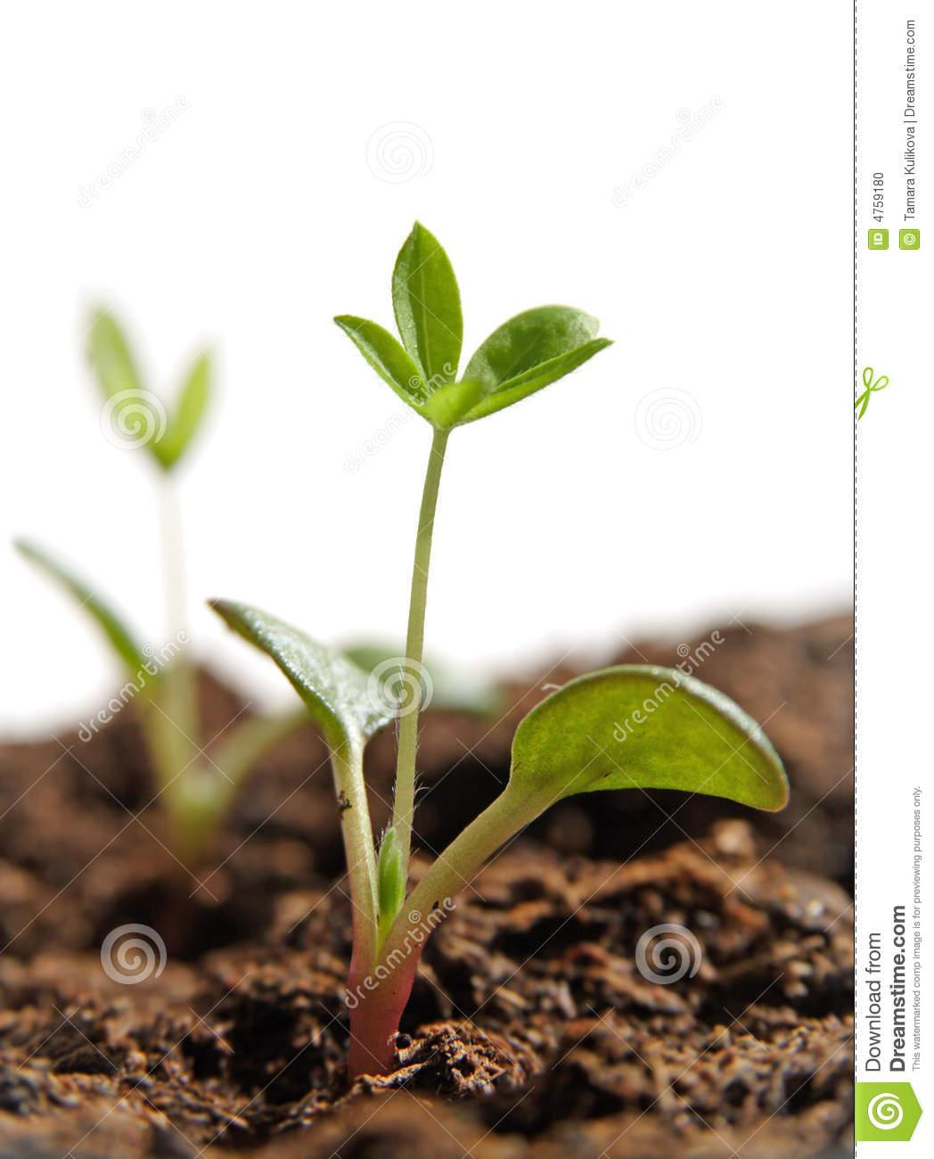
What happens to the glucose?
Glucose is used in plant cells for energy.
Plants also use it to make other carbohydrates, proteins, and lipids,which are needed to make more of the plant.

Slide 22
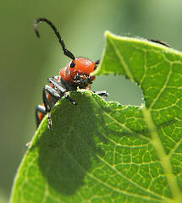
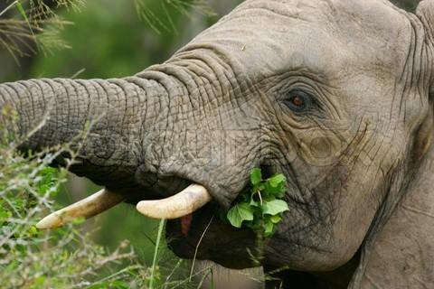
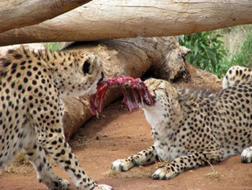
What happens to the glucose?
Plants are consumed by herbivores and omnivores, who use the macromolecules for energy and growth.
Carnivores hunt and eat herbivores and omnivores for their source of energy.

Slide 23
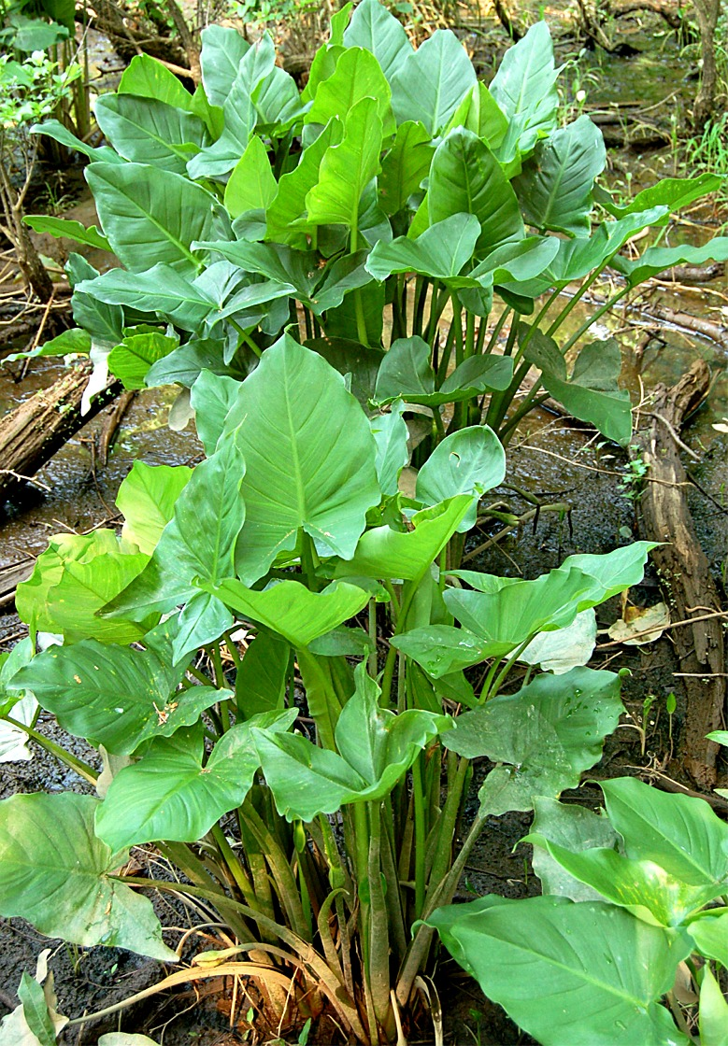
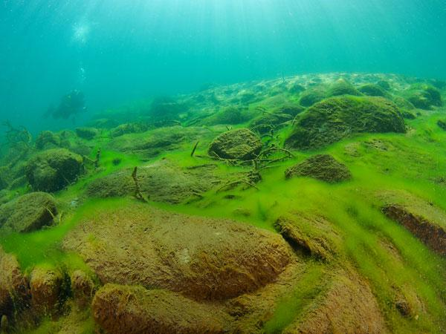
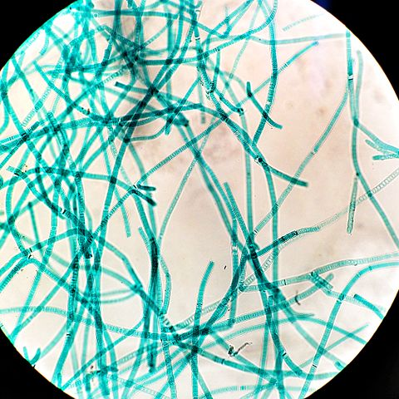
Organisms that can do photosynthesis
Plants
Algae
Cyanobacteria

