Slide 1
3 Note Cards
1. Decomposer (Detritivore)
2. Producer
3. Consumer
* Word and picture on the front/ definition on the back

Slide 2
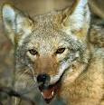
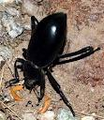
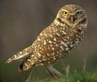
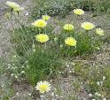
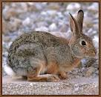
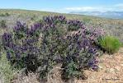
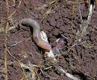
- Use the following desert organisms to draw a food web. - Draw the arrows in the direction of nutrient/energy flow - Label the decomposers, producers and consumers.
Coyote Stink bug Burrowing owl Grasshopper Mouse
Desert Desert Indigo Bush
Dandelion Cottontail Earthworm

Slide 3
Answer the following questions on the bottom of your food web.
What would happen to the other organisms if the coyote went extinct?
What would happen if there was a long term drought and all of the producers disappeared ?
What would happen if all of the decomposers disappeared?

