Slide 1
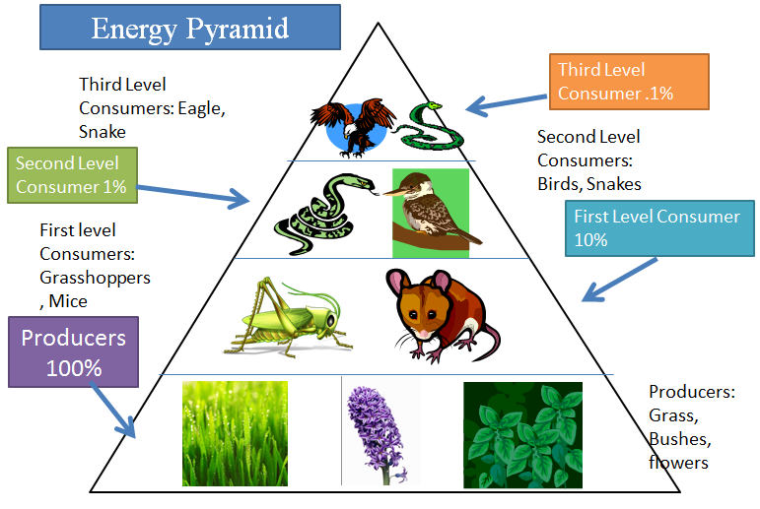
Energy Pyramids

Slide 2
Side 1: Choose a biome (ocean, desert, tropical etc.)
Draw 4 organisms that represent a food chain. The base (largest section) must contain a producer, the next level up must eat that producer (primary consumer), the next level up (secondary consumer) must eat the primary consumer and the top (smallest) section must contain an organism that eats the secondary consumer.
Must use at least 4 colors

Slide 3
Side 2:
Label the base (largest section): PRODUCERS
Label the next section above: PRIMARY CONSUMERS
Label the next section above: SECONDARY CONSUMER
Label the top (smallest section): TERTIARY CONSUMER

Slide 4
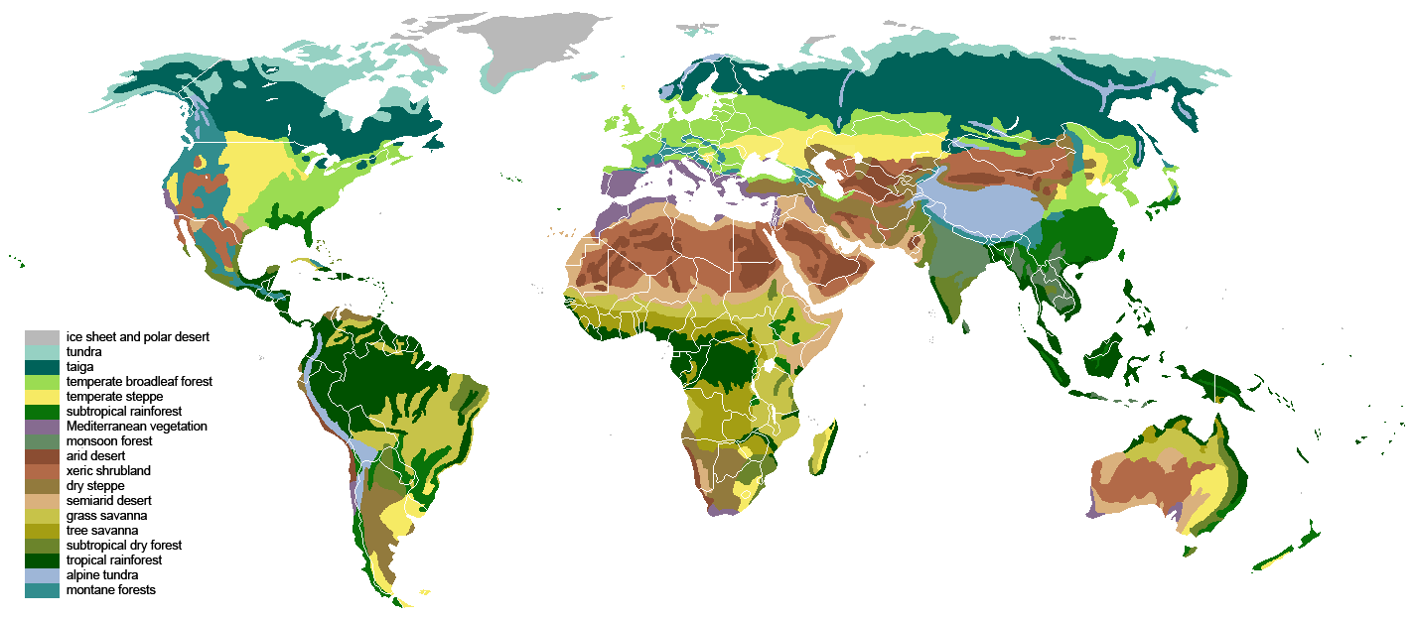
Side 3:
Choose (draw and color using at least 4 colors) 4 organisms to represent a food chain that would be found in a different biome that what you chose for side 1. Make sure that you have a producer as your base.

Slide 5
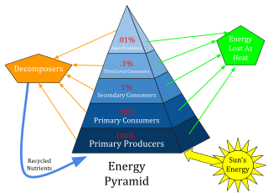
Side 4:
Label the base: 100%
Label the next section up: 10%
Label the next section up: 1%
Label the top (smallest) section: 0.1%
To represent the flow of energy in a food web and the
loss of energy to the environment

Slide 6
Summary of Instructions
Side 1: Drawn food chain from same biome
Side 2: Label: Producers, primary consumers, secondary
consumers, tertiary consumers.
Side 3: Drawn food chain from a second biome
Side 4: Label Energy: 100%, 10%, 1% and 0.1%
**** Must use at least 4 colors****

Slide 7
Analysis
What is another word that means consumer? _______________
What is another word for a producer? _______________________
What happens to the energy that does not transfer to the next level?
Do you get more energy from eating a steak or a salad?
Explain why?

