Slide 1
Biomes

Slide 2
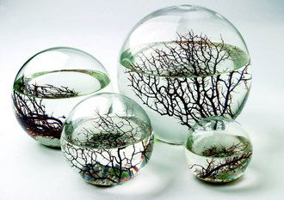
Enclosed Biomes

Slide 3
Goal of Biome Project
With your table, you will make an enclosed biome that will survive on its own for up to three weeks!
At the end of the three weeks, you will be able to explain why!
Grade counts as classwork/HW/test

Slide 4
Biome must include:
At least two plastic bottles (or an approved set-up)
See teachengineering.org etc.
at least 1 plant
at least 1 living organism (insect or invertebrate preferably)
If you have a more creative idea, I am willing to hear it
The animal and the plant must have all the things that they need to survive, such as water and something to support them (like soil)
The biome must be completely sealed off from the outside environment, meaning no air can get in and no air can get out

Slide 5
Your table’s goal for today:
Plan out your proposal (Tomorrow you will write your formal proposal):
Design an enclosed bottle biome to house your chosen plant and animal.
Design must be drawn in great detail on a sheet of paper with everything labeled clearly.
You must describe who is responsible for bringing each component for the biome. Your group must supply everything except packing tape and string. I will also have some potting soil.
You must also do research on the type of plants and animals that you want to use and figure out where are you going to get them

Slide 6
Create a biome presentation
Name it: period biome table
(example: 3biome5)
Share it with each other so that you all can edit and with me srobles@psusd.us so I can grade it.
Slide 1: Proposal (Write a paragraph explaining your proposal - basic design elements, plants, animals and which team member is responsible for bringing in each part).

