Slide 1
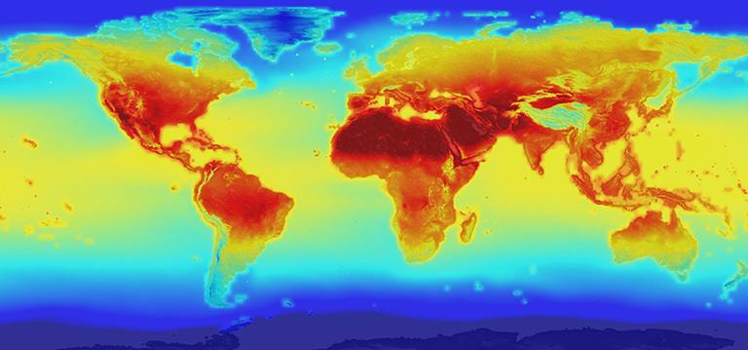
Climate Change
Climate change is happening.
Humans are largely responsible for recent climate change.
1. What human activities do you think are contributing to the change in climate?

Slide 2
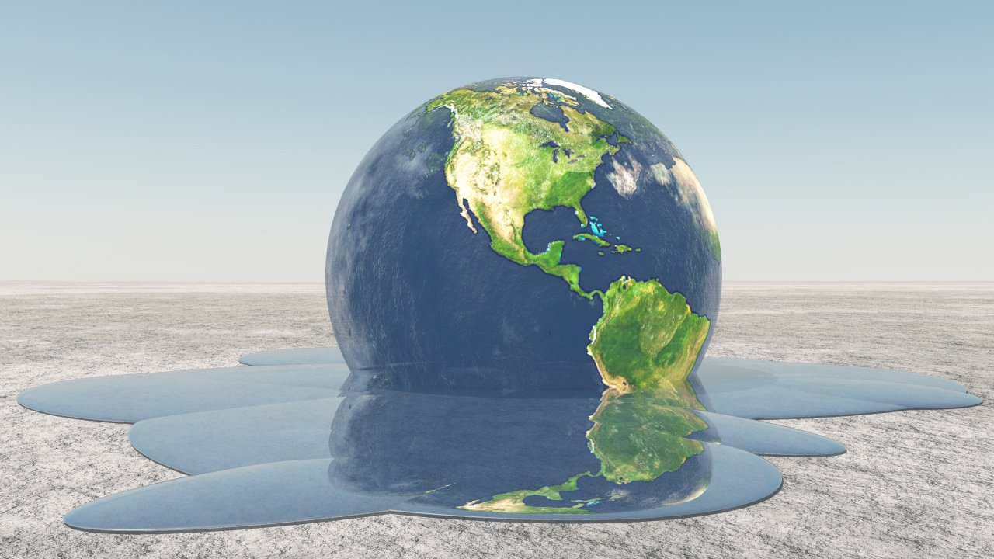
Greenhouse Effect?
2. How do humans contribute to the levels of carbon dioxide, nitrous oxide and methane in the atmosphere?
Notes:
2 minutes (cars, planes, factories - burning fossil fuels - discuss)

Slide 3
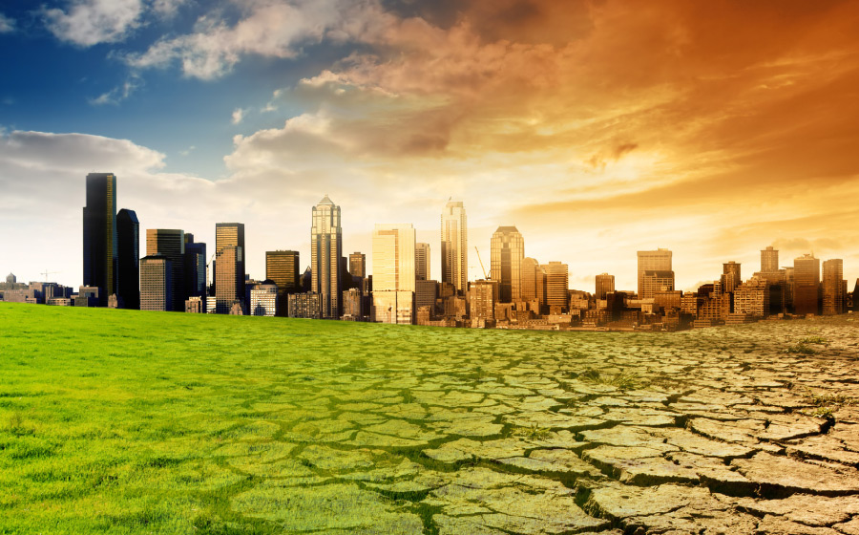
effects on earth’s organisms
Earth’s average temperature has risen 1.5ºF over the past century and is projected to rise another 0.5 to 8.6ºF over the next hundred years.
3. Predict how small changes in the temperature of the planet can affect the organisms on earth.
4. What is one example from the video of an effect of global warming on an organism.

Slide 4
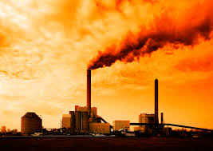
Evidence of climate change
5.How long have scientists been studying climate change?

Slide 5
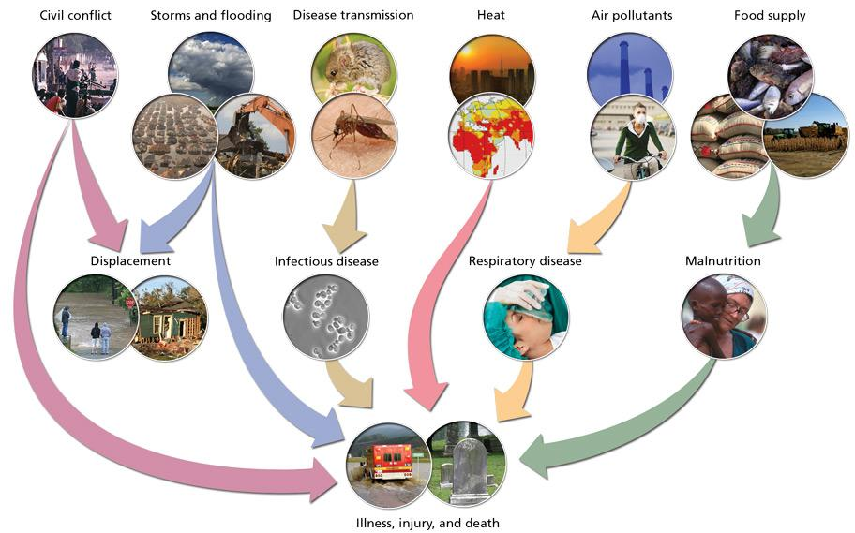
Effects of climate change on human health
6.List 5 possible effects of climate change on human health

Slide 6
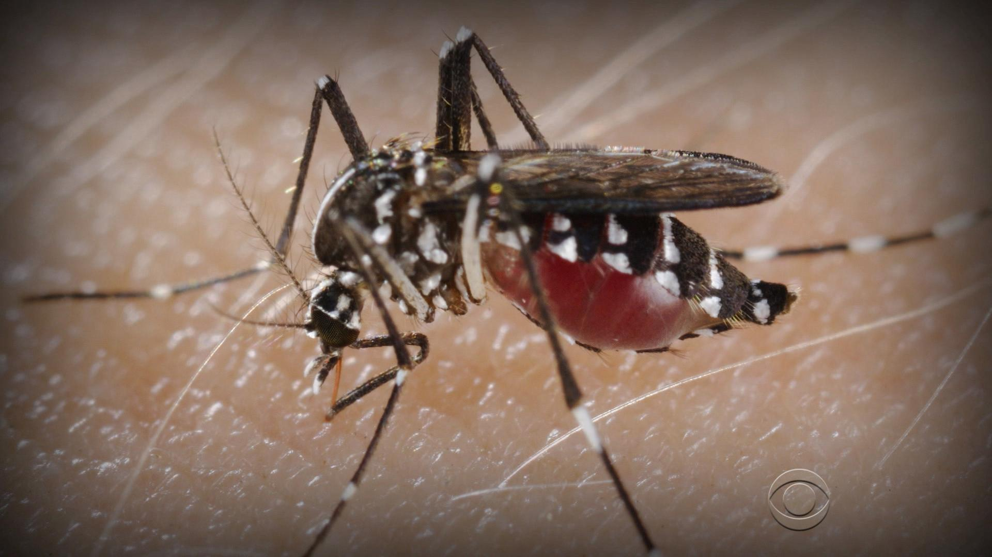
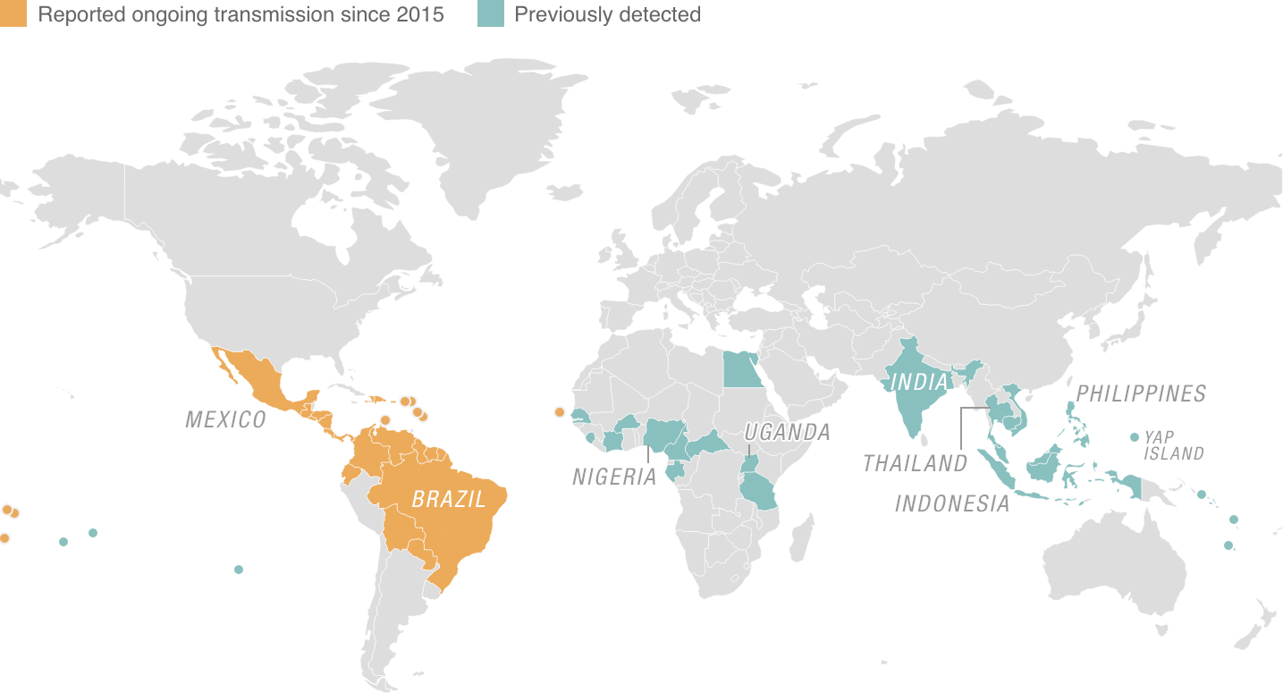
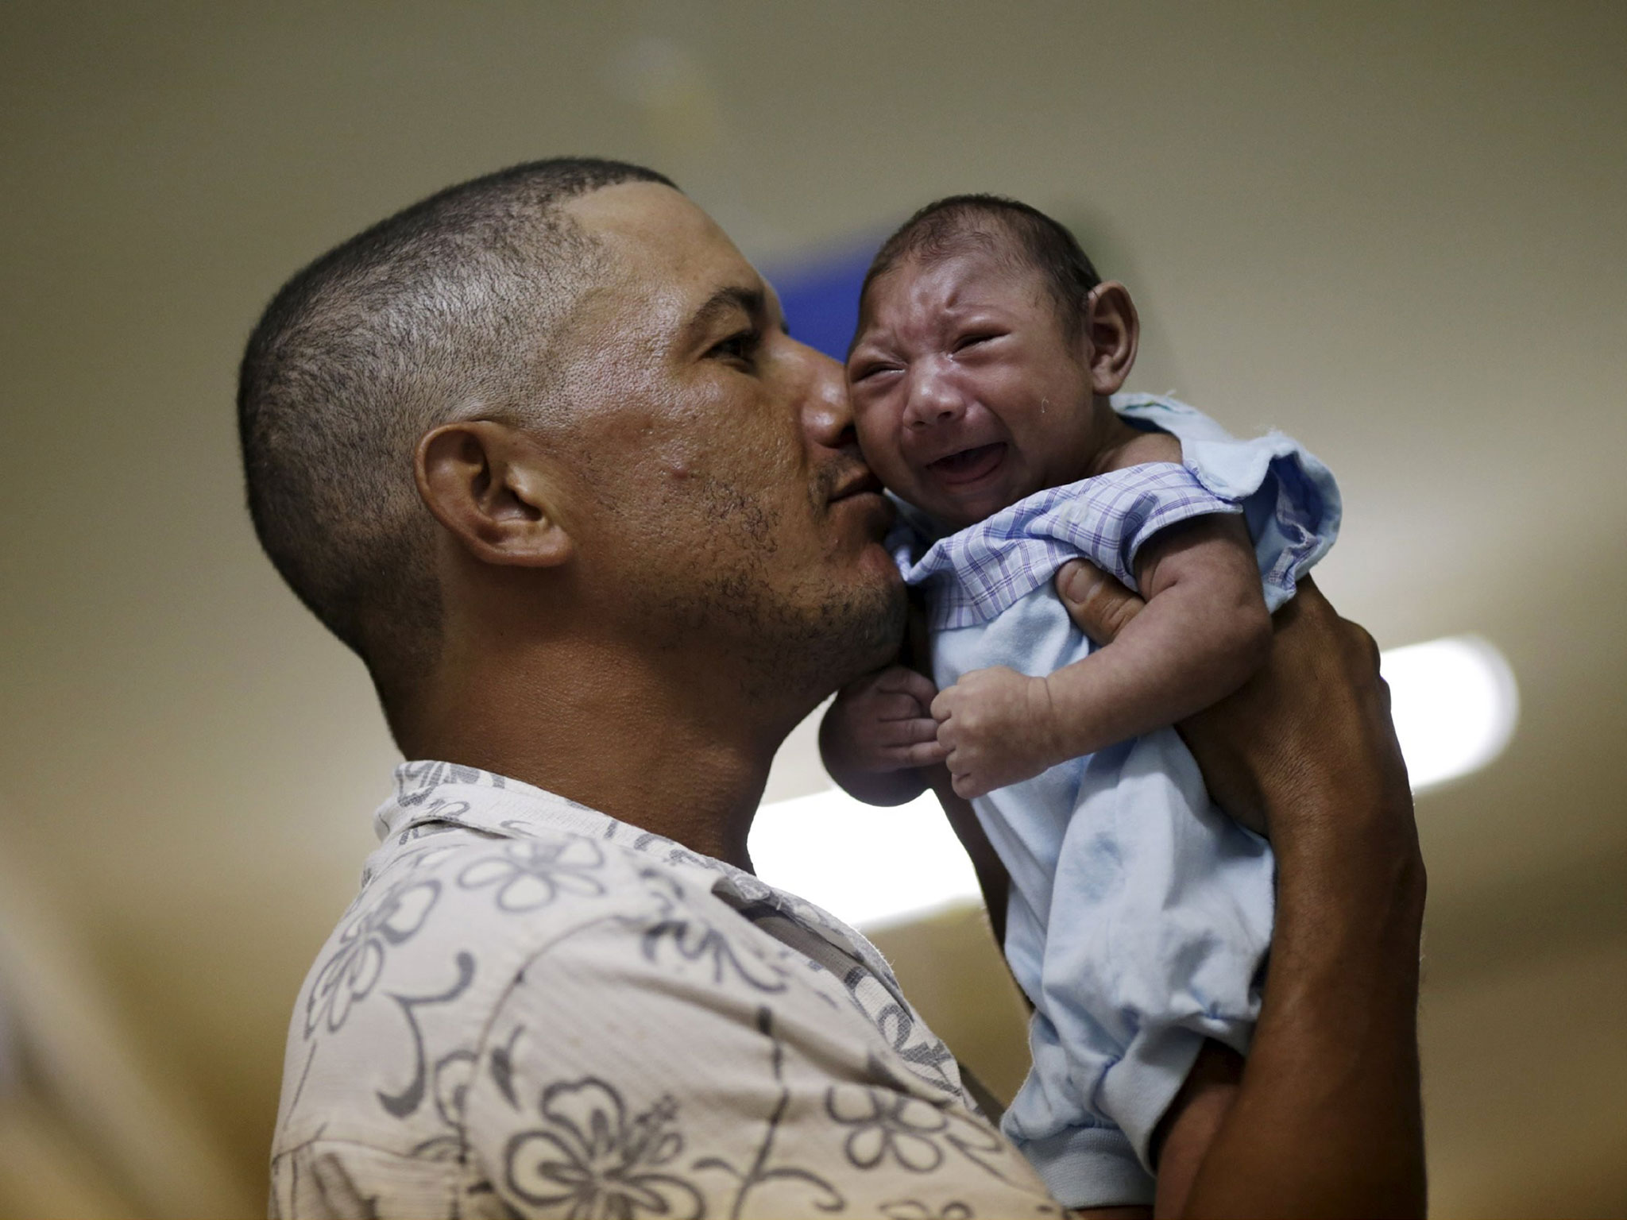
Zika virus
7. What is
the connection
between Zika
and climate
change?

Slide 7
8. What are 3 things that you can do to slow climate change?

