Slide 1
Cell Membranes (Our phospholipid bilayers)
-Number paragraphs
-Underline/Highlight key ideas
- “?” next to parts you are unsure of
-Add following notes to page 24

Slide 2
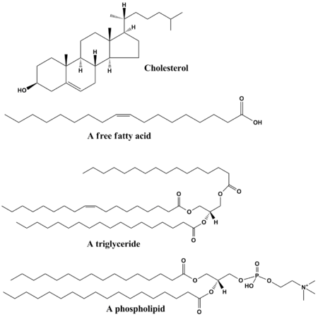
Lipids
Naturally occurring molecules that include fats, oils, waxes, sterols and triglycerides.
The main functions of lipids include storing energy, signaling and acting as structural components of cell membranes.

Slide 3
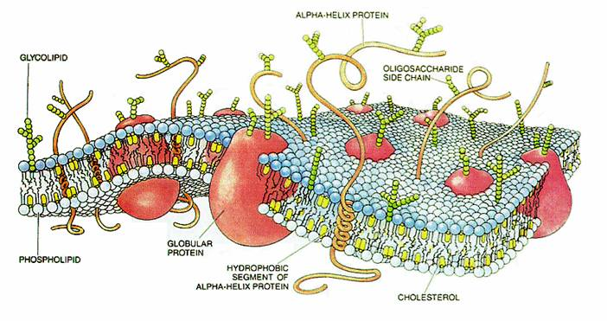
Cell (plasma) membrane
YouTube (Plasma Membrane JCCC video) 5:15

